Slide 1

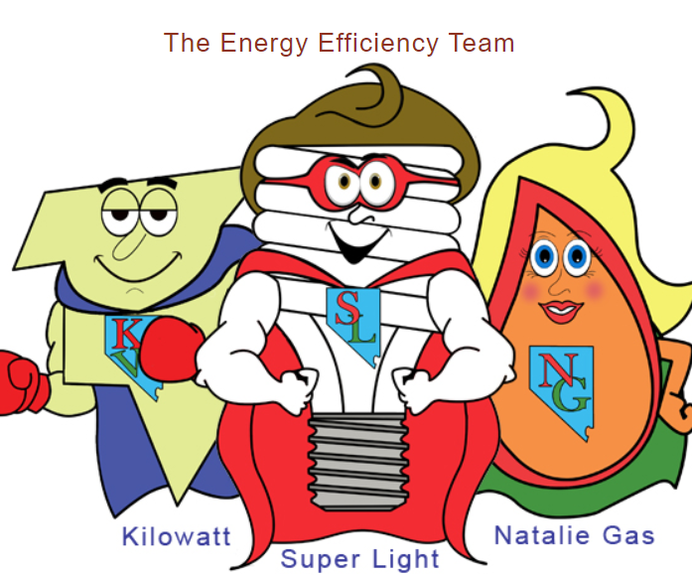
Regulatory Review of Nevada’s Participation in a Regional Energy Market
Speaker: Hon. Tammy Cordova
Commissioner
Public Utilities Commission of Nevada
Las Vegas Office
www.puc.nv.gov

Slide 2
Agenda
Regional Energy Markets Defined
Commission Jurisdiction and History
Investigatory Docket
Order on Day Ahead Markets (“DAM”)
Further Investigation on Regional Transmission Organizations (“RTO”)

Slide 3
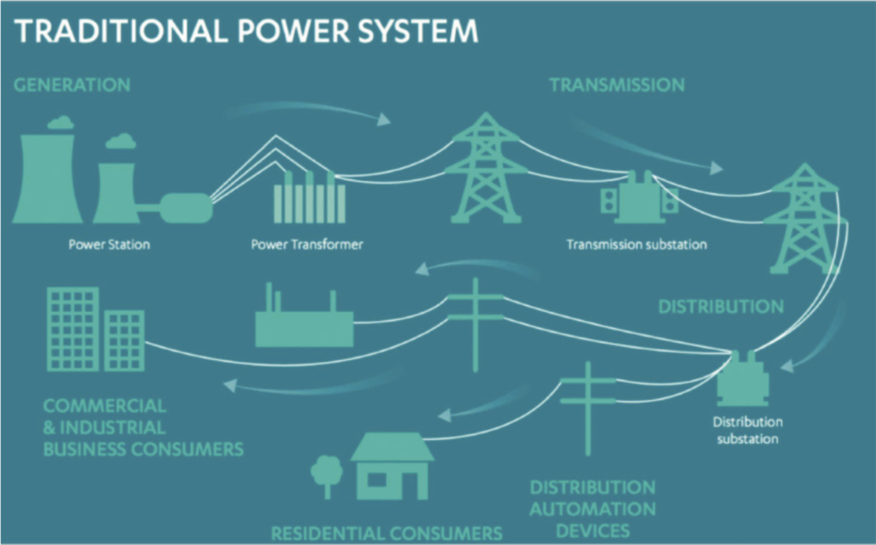
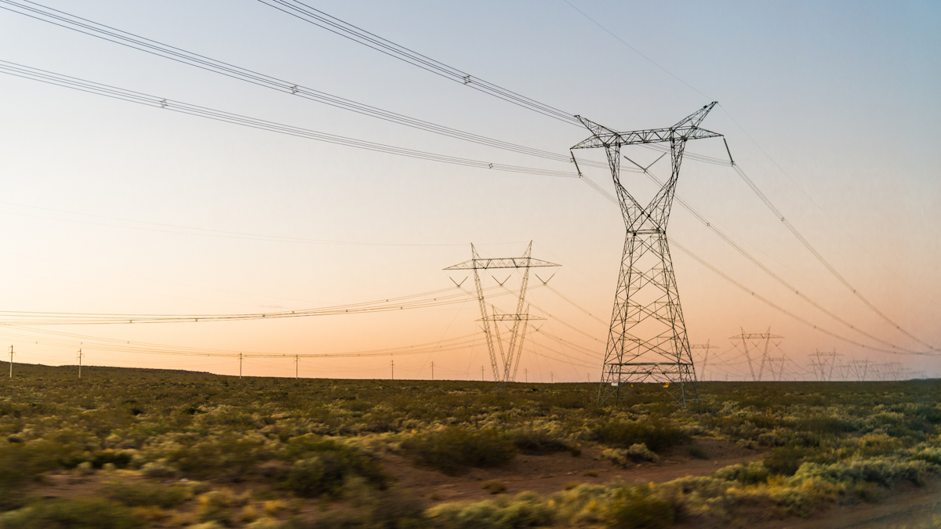
• Energy markets are auctions that are used to coordinate the production of electricity on a day-to-day basis.
• In an energy market, electric suppliers offer to sell the electricity that their power plants generate for a particular bid price, while load-serving entities (the demand side) bid for that electricity to meet their customers’ energy demand.
• Supply side quantities and bids are ordered in ascending order of offer price.
• The market “clears” when the amount of electricity offered matches the amount demanded, and generators receive this market price per megawatt hour of power generated.
Regional Energy Markets Defined
Image from www.thecgo.org/research/innovations-and-decentralized-energy-markets/

Slide 4
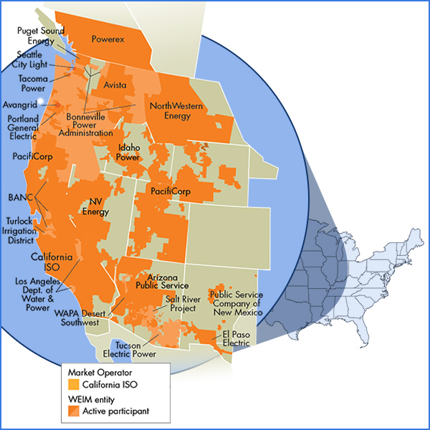
What is an Energy Imbalance Market (“EIM”)?
• An EIM is a real-time energy supply market that offers electricity generation and transmission services.
• The real-time energy market, or spot market, allows buyers to purchase electricity for immediate use, balancing actual demand and system constraints with the purchase commitments made the previous day.
• The real-time market typically runs once per hour and once every five minutes to manage real-time load changes and real-time pricing. This can increase the economic efficiency of the power system and provides centralized, automated and region-wide generation economic dispatch.
Image from www.caiso.com

Slide 5
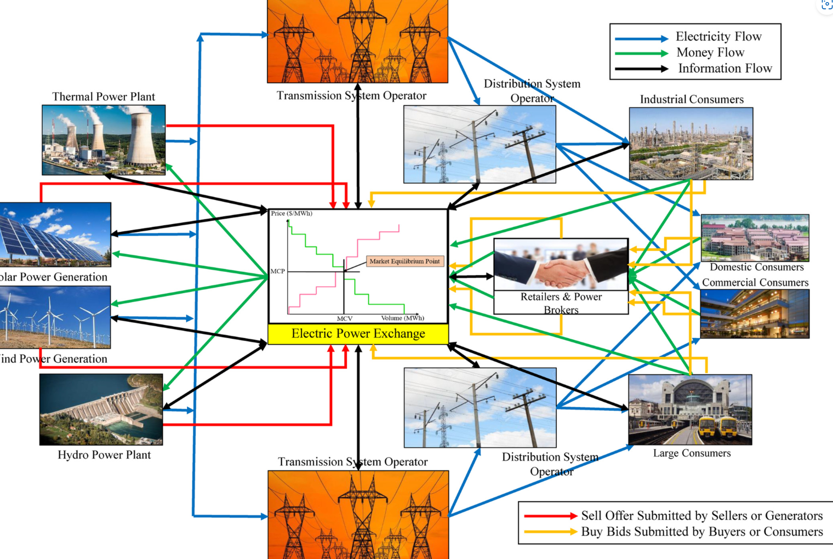
Day Ahead Energy Market
The day-ahead energy market evaluation is conducted the day prior to when the energy will be consumed — typically in the morning. Buyers agree to purchase a set amount of electricity from sellers at the market price and both parties are committed — the buyer must buy, and the seller must sell.
Image from www.onlinelibrary.wiley.com/doi/full/10.1002/2050-7038.12360

Slide 6
• Management of the bulk power transmission system within its footprint
• Ensuring non-discriminatory access to the transmission grid by customers and suppliers
• Dispatch of generation assets within its footprint to keep supply and demand in balance
• Regional planning for generation and transmission
A Regional Transmission Organization (RTO) or
An Independent System Operator (ISO)
includes both markets
+
Much more!

Slide 7
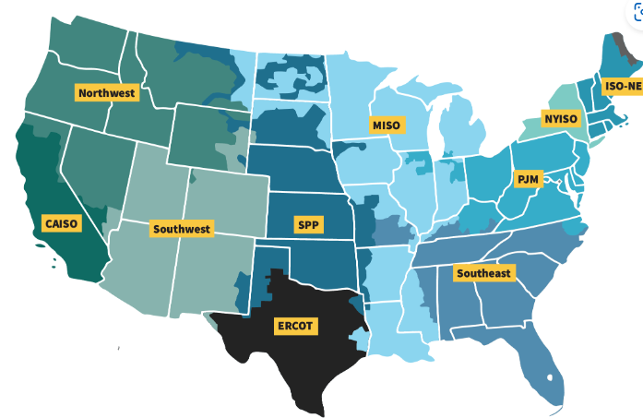
Regional Transmission Organizations (RTO)
• RTOs are regulated by the Federal Energy Regulatory Commission (FERC), not the states, because the energy is transmitted in interstate commerce.
• FERC Order 2000 encouraged all transmission owning entities to join an RTO.
• Membership in an RTO is voluntary.
• Most of the western US does not currently belong to an RTO.
Image from www.ferc.gov

Slide 8
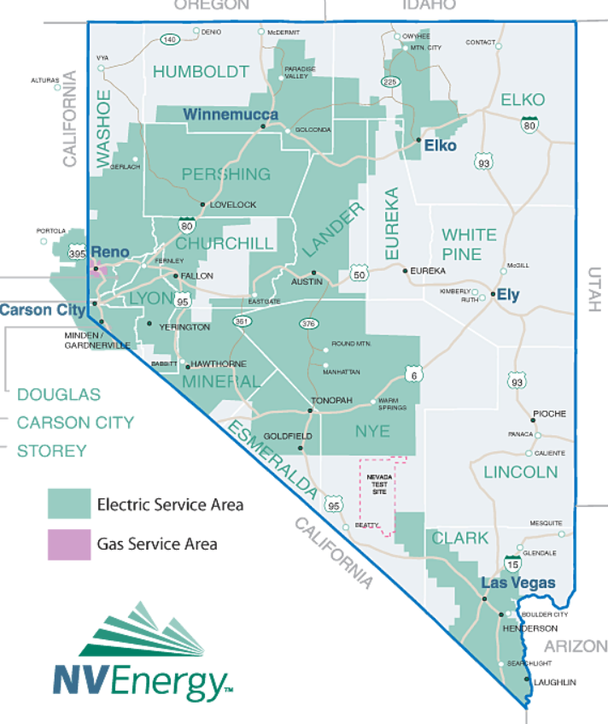
Commission
Jurisdiction and History
The Public Utilities Commission of Nevada has authority to set electric utility rates, approve electric utility plans to serve its load and maintain resource adequacy, and ensure compliance with state law.
NV Energy is an electric utility that is jurisdictional to the Commission.

Slide 9
Senate Bill 448 / NRS 704.79886
Section 30 of SB 448:
The Commission shall require every transmission provider in this State to join a regional transmission organization on or before January 1, 2030.
• A Nevada electric utility is required to obtain authority from the Commission for its plan to provide safe, reliable service. The plan includes how it will provide adequate energy. Some of that energy is purchased from other entities in the western United States.
• In 2014, NV Energy obtained authority to join the CA ISO Energy Imbalance Market.
• In 2021, the Nevada Legislature enacted SB 448.

Slide 10
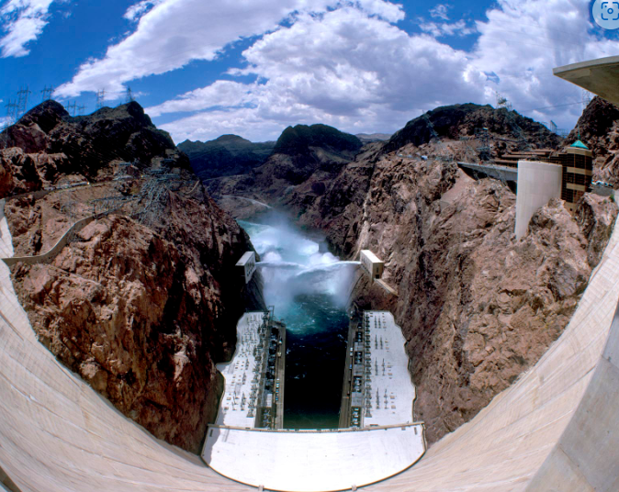
A Nevada electric utility may request authority from the Commission to join a Day Ahead Market AND/OR an RTO
Nevada is unique.
A single electric utility, NV Energy, provides electric service to almost 90% of Nevada’s residents and businesses.
Nevada is a single transmission balancing area in which NV Energy manages the entire transmission system.
Nevada has a renewable energy mandate in state law.
Image from obamawhitehouse.archives.gov/blog/2015/07/07/day-history-construction-began-hoover-dam

Slide 11
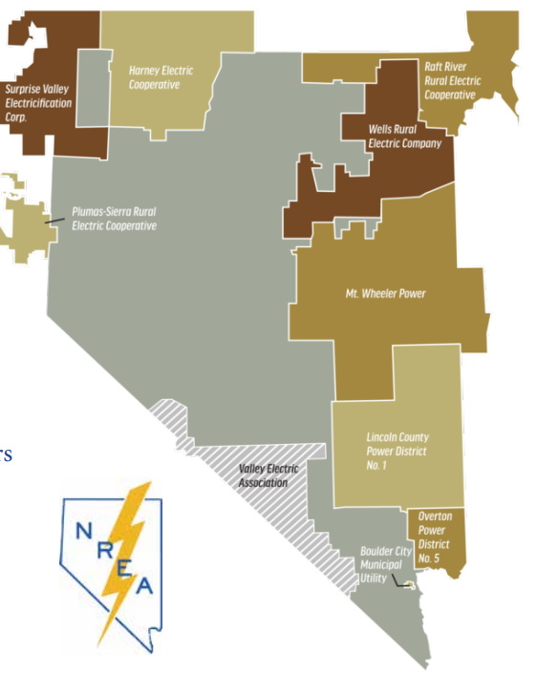
Nevada Rural Electric Association
The Nevada Rural Electric Association (NREA) was founded in 1974 to represent the collective interests of one municipal utility, six rural electric cooperatives and three power districts and their consumers across Nevada. Five NREA members are based in Nevada while four serve consumers in Nevada but have headquarters in the adjacent states of Idaho, Utah, Oregon and California.
Members of the NREA are generally NOT jurisdictional to the Commission for rates and energy planning. However, they are within NV Energy’s transmission balancing area. NREA members are affected by any decision of the Commission regarding a DAM or RTO.

Slide 12
Investigation regarding regional market activities in the western interconnection relevant to Nevada utilities’ obligations pursuant to NRS Chapter 704.
PUCN Investigatory Docket
Docket No. 23-10019

Slide 13

The Commission’s Investigatory Docket
Docket No. 23-10019
The Commission has held three public workshops and sought three rounds of comments from interested stakeholders during Phase I in this docket over the past year.
Workshops included presentations from:
The California Independent System Operator (CA ISO).
And
The Southwest Power Pool (SPP).
• CA ISO has a day ahead market offering called Extended Day Ahead Market (EDAM).
• SPP has a day ahead market offering called Markets+.
• 22 Separate comments were filed from 13 different stakeholders.

Slide 14
Order Adopting the Report dated: June 21, 2024
The Report provides recommendations regarding the requirements for an electric utility’s application to join a day-ahead market (“DAM”) following the first phase of the investigation. The next phase of the investigation will gather information regarding other regional market activities in the Western Interconnection, including regional transmission organizations (“RTOs”) and independent system operators (“ISOs”).

Slide 15
The Report – Topics That Will Form the Framework of an Application
An overview of the DAM, including:
  Governance of the DAM and the overall organization of the entity that owns the DAM, including the process by which changes to the FERC-approved DAM tariff occur, to include any opportunities for the Commission to participate in the DAM change process prior to a filing at FERC;
  Overall financial health of organization that owns the DAM, as well as the financial statements of that organization;
  An explanation of the market monitoring function at the DAM, the dispute resolution process at the DAM, and the functioning of the DAM states committee;
  Current non-Nevada utility commitments and the nature of those commitments to the DAM;
  Diversity of resources available through the DAM ;
  Resiliency of the DAM system to physical threats, such as wildfire, and vulnerability to cyber-security threats;
  Transparency of the DAM’s market data;
    Type and location of the data currently available;
    Type and location of the data that will be available after NV Energy joins;
    How the Commission can access the data; and
    Frequency with which the data is/will be available to the Commission;
  GHG emission tracking of resources purchased in the DAM, as well as any “leakage” that might occur;

Slide 16
The Report (Continued)
Status of the DAM and applicable timeline for the DAM and NV Energy joining;
  Copies of all DAM implementation agreements;
  Any related or required amendments to NV Energy internal business practices and procedures;
Interoperability with the WRAP, NV Energy’s ESP, and state resource adequacy requirements;
Impact on NV Energy’s Renewable Portfolio Standard compliance;
Roadmap to RTO in compliance with NRS 704.79882 if the DAM is joined;
Revisions to the OATT that NV Energy will make once it joins the DAM. Complete tariff language may not be necessary, but an adequate level of detail to allow review of the potential impact on NV Energy’s BAA;
Concerns regarding impacts of the DAM on non-jurisdictional transmission customers in NV Energy’s BAA, including:
  Pricing and settlement transparency;
  Participation and representation in the DAM; and
  Responsibilities of those customers with respect to the resource adequacy and compliance obligations;
Process by which the DAM and NV Energy ensure retail customers are compensated for available transmission capacity, including congestion revenues;

Slide 17
The Report (Continued – Part 2)
All cost-benefit analyses that demonstrate the value of the DAM versus other options, including any viable, alternate DAMs and the “status quo”, that examines, at a minimum, the following information:
  Impact of transfers between markets and balancing areas;
  Analysis of resource procurements;
  Any costs related to solar energy curtailment;
  Use of the most recently available applicable to Nevada-specific inputs;
  Impact on transmission development and investments currently proposed or in progress for Nevada by NV Energy or other developers; and
  Impact on generation development currently approved or proposed by NV Energy;
Any capital investment in transmission or generation that may be necessary to participate in the DAM or maximize the benefit of the DAM;
Costs of utility participation in the DAM, including fees, metering and software requirements. All new costs should be highlighted and estimated based on the most applicable, recent data, even if they are not yet known with precision or are expected to be offset. Any expected offsets should be thoroughly analyzed;
Forecast of rate and revenue impacts for the 5 and 10 years immediately after joining the DAM; and
Process, timeline and costs to exit the DAM.

Slide 18

NV Energy may file an application with the Commission later this year to request authority to join a DAM
Any request would be docketed, reviewed, and public hearings held.

Slide 19
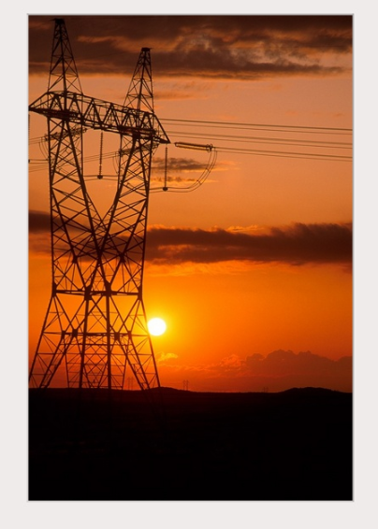
The Commission will continue its investigation into regional energy markets
Next up...Phase Two!
• Phase Two is the requirement to join a Regional Transmission Organization codified in NRS 704.79886 / SB 448.
• What type of organization would be best for Nevada and what options are available?
• Are additional rules needed?

Slide 20
Thank you! www.puc.nv.gov

