Slide 1
WestTEC and FERC Order 1920 Updates for NV Transmission Task Force
August 25, 2026
Western Interstate Energy Board

Slide 2
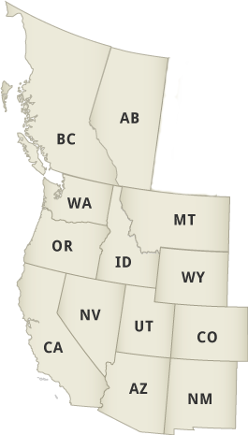
What are WIEB and CREPC?
The Western Interstate Energy Board (WIEB),originated in the 1970s and is composed of one representative (typically from the energy office) appointed by the governor or premier of each of 11 Western states and 2 Canadian provinces.
  WIEB has grown over the years, and currently independently staffs several other regional committees, including WIRAB, CREPC, COSR, BOSR, and the MSC.
The Committee on Regional Electric Power Cooperation (CREPC) was established in 1982 as a joint committee of WIEB and the Western Conference of Public Service Commissioners to focus on electric power system policy issues that require regional cooperation in the West.

Slide 3
Western Transmission Expansion Coalition (“WestTEC”)

Slide 4
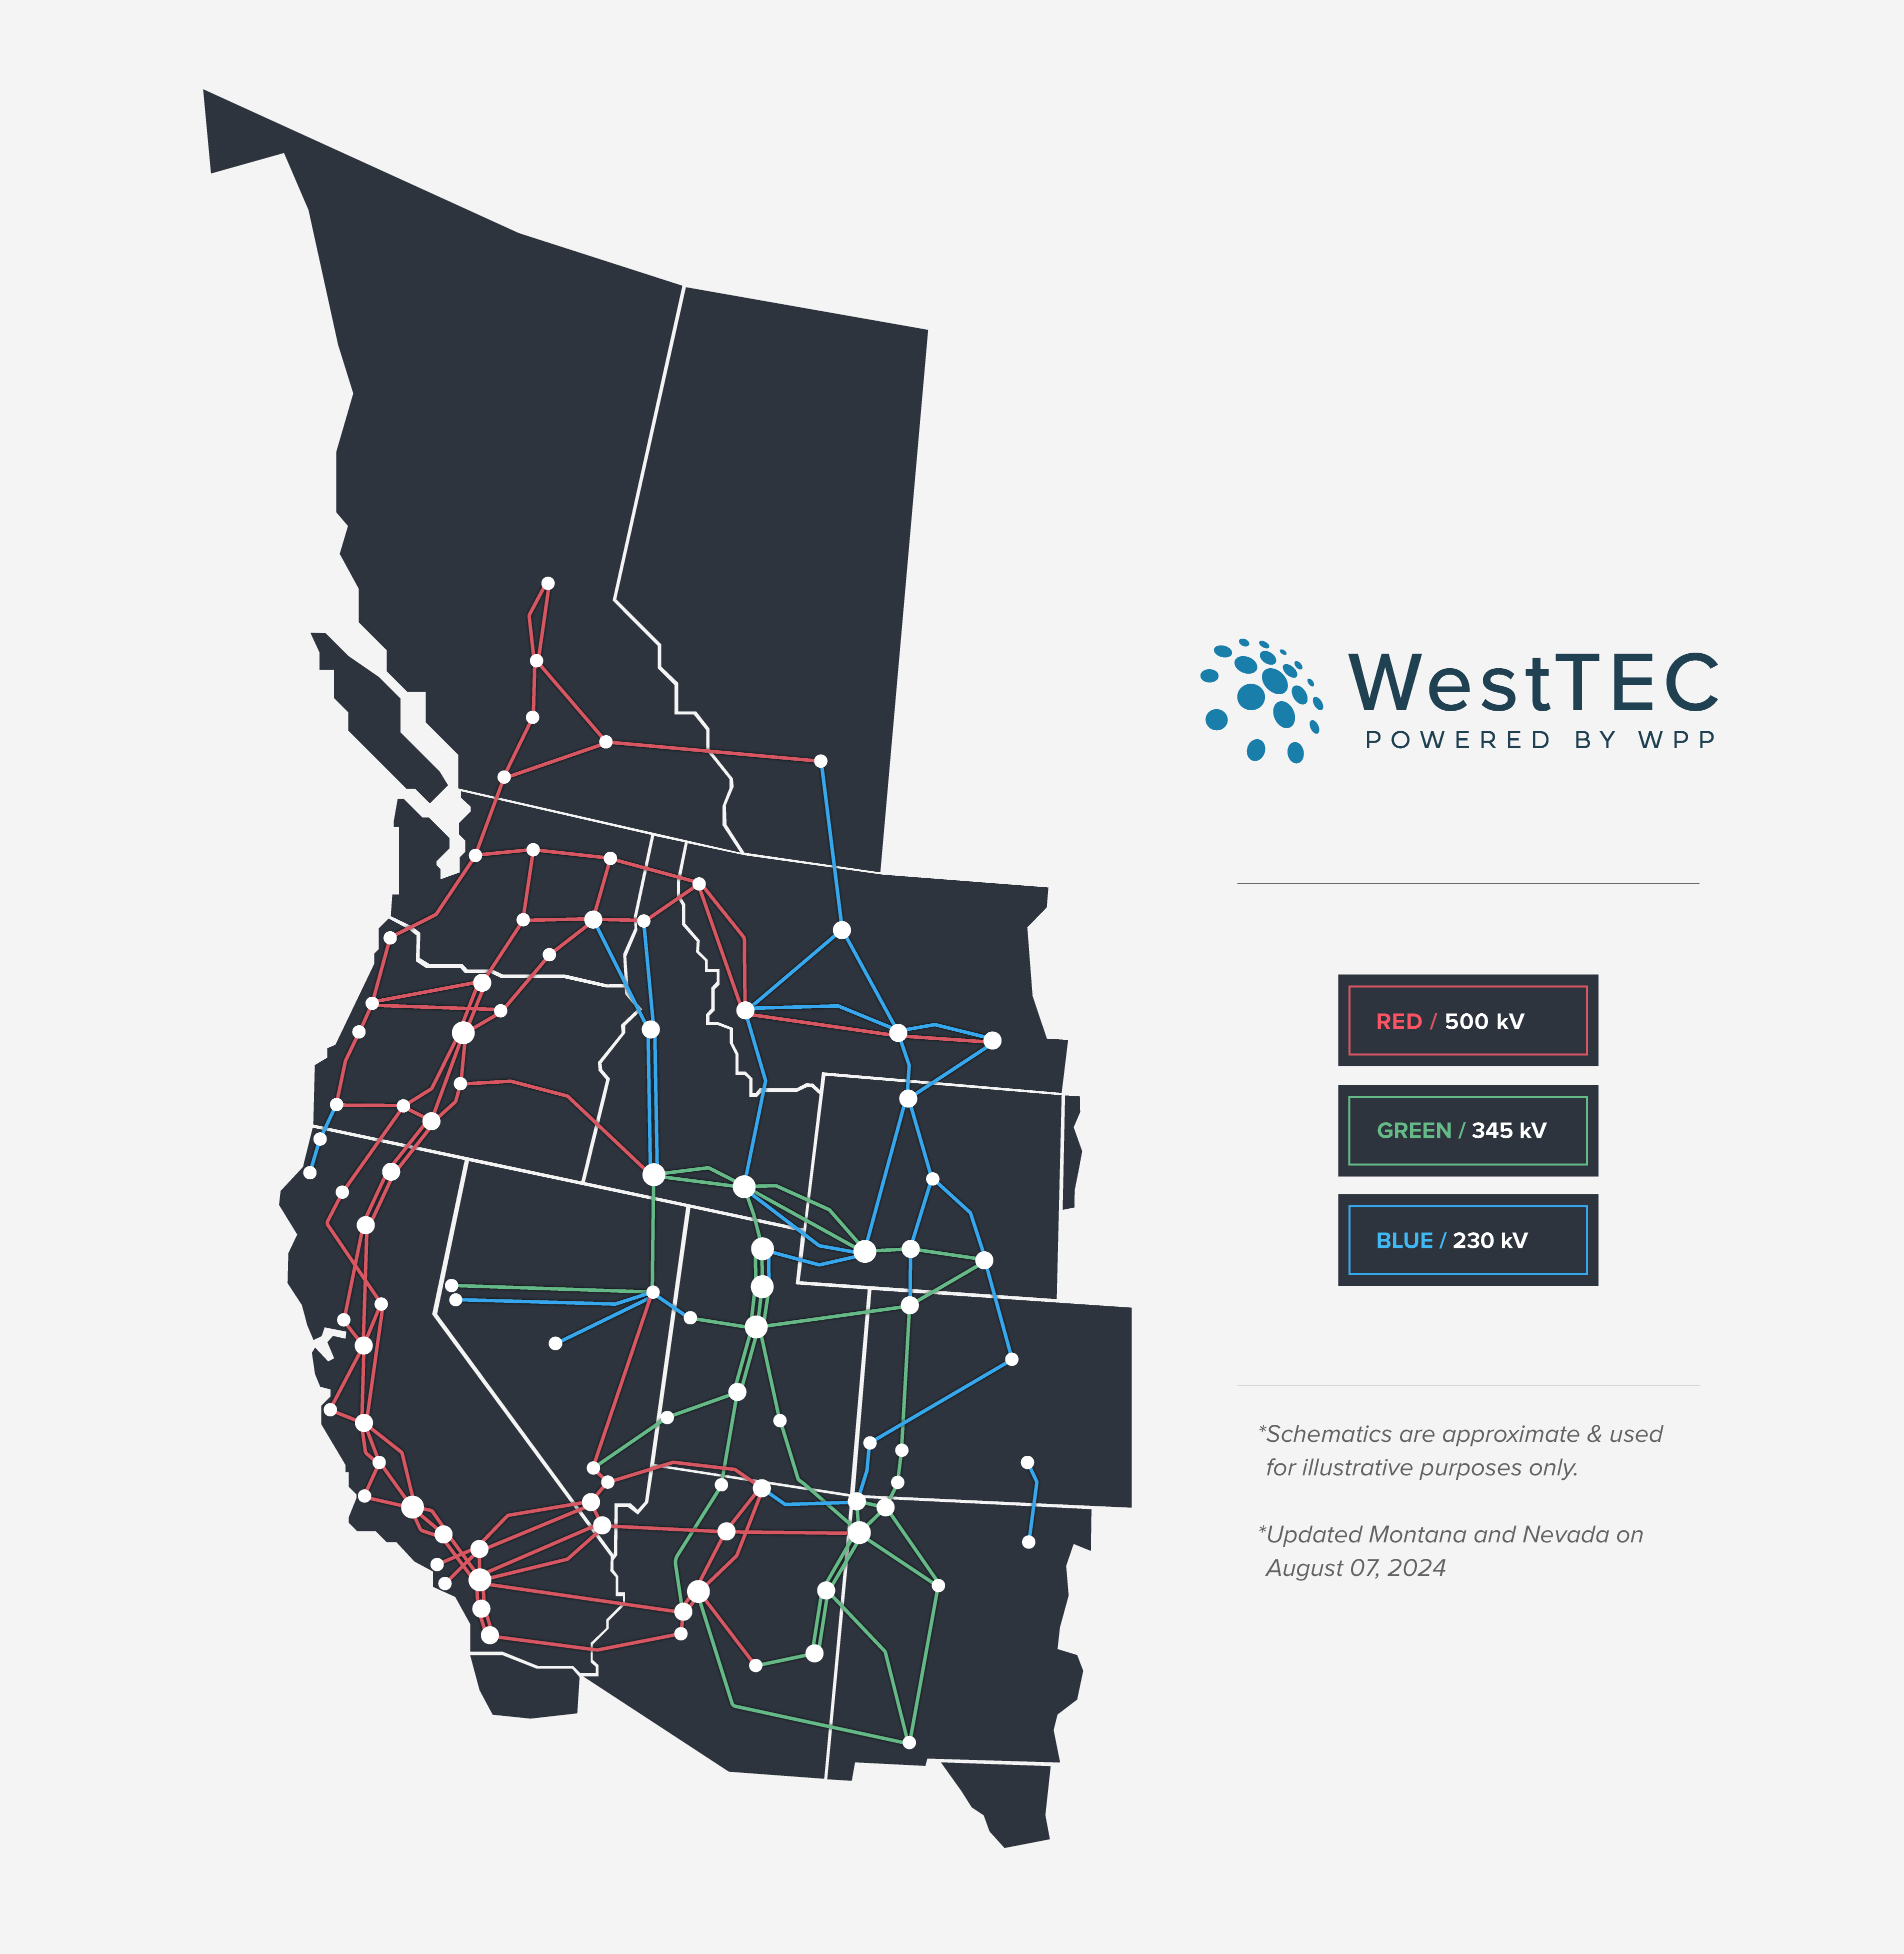
Western Transmission
Expansion Coalition – “WestTEC”
West-wide 10 and 20-year transmission study
Industry-led with unprecedented regional partner inclusion
Goal is to produce an actionable transmission study

Slide 5
WestTEC Regional Partners – Over 70+
Western Interstate Energy Board GridWorks Western Electricity Coordinating Council Connected Grid Initiative Wyoming Office of Consumer Advocate Public Advocates Office at the California Public Utilities Commission Bonneville Power Administration Grid United Clean Energy Buyers Association Amazon Energy PacifiCorp Puget Sound Energy Portland General Electric Renewable Northwest Snohomish PUD Tucson EPC Grant County PUD Western Power Pool GDS Consulting | Washington Department of Commerce Interwest Energy Alliance Invenergy Idaho Power Company NorthWestern Energy NV Energy Salt River Project Arizona Public Service Public Service Company of New Mexico Western Area Power Administration WestConnect NRDC Northwest & Intermountain Power Producers Coalition Public Power Council Colorado River Energy Distributors Association LS Power Tacoma Power New Mexico RETA | Northwest Requirements Utilities PNGC Western Resource Advocates Clean Energy Transition Institute NW Energy Coalition From the Light Consulting Navajo Transitional Energy Company Warm Springs Power & Water Enterprises Avangrid Renewables EDF Renewables Aypa Power Grid Strategies PG&E Southern California Edison Seattle City Light Black Hills Energy LADWP GridLab The Public Generating Pool | California ISO Southwest Power Pool Avista Xcel Energy Powerex BC Hydro GridLiance Pacific Northwest Utilities Conference Committee Pattern Energy Cascade Renewable Transmission Chelan County PUD Pacific Northwest National Laboratory Northwest Power and Conservation Council Whatcom County PUD Savion E3 Energy Strategies

Slide 6
WestTEC Project Timeline & Future
NEAR-TERM PLANNING HORIZON EFFORTS
LONG-TERM PLANNING EFFORTS
PROJECT DISTRIBUTION & REGIONAL PARTNER ENGAGEMENT
QUARTERLY PUBLIC ENGAGEMENT
2024
Q3
2024
Q4
2025
Q1
2025
Q2
2025
Q3
2025
Q4
2026
Q1
2026
Q2
2026
Q3
2026
Q4
2027
Q1
WE ARE HERE!
Mar 2025:
Steering Approves Scenarios
Feb 4, 2026: Public Workshop
Sept 2024: Final Study Plan
Sept 2026: Completion of 20-year Horizon Report and Final 10-year Horizon Report
Feb 4, 2026:
I0-year Horizon Report Published

Slide 7
Critical Input: Resource Mix and Busbar Mapping
WestTEC 2035 Reference Case Resource Mix (GW)
Busbar Mapping of Conceptual Resource Additions
Resource Type | 2024 | 2035 WestTEC Reference Case
Natural Gas | 109 | 97
Hydro | 75 | 70
Solar PV | 44 | 115
Wind | 39 | 87
Coal | 22 | 9
Battery Storage | 16 | 70
Nuclear | 7 | 6
Other | 5 | 35
Geothermal | 4 | 7
Total | 322 | 495
The “Other” category includes pumped storage, solar thermal, biomass, and alternative-fuel thermal generators.
WestTEC developed a busbar mapping framework to allocate roughly 87 GW of un-sited conceptual resources from utility IRPs to substations across the region

Slide 8
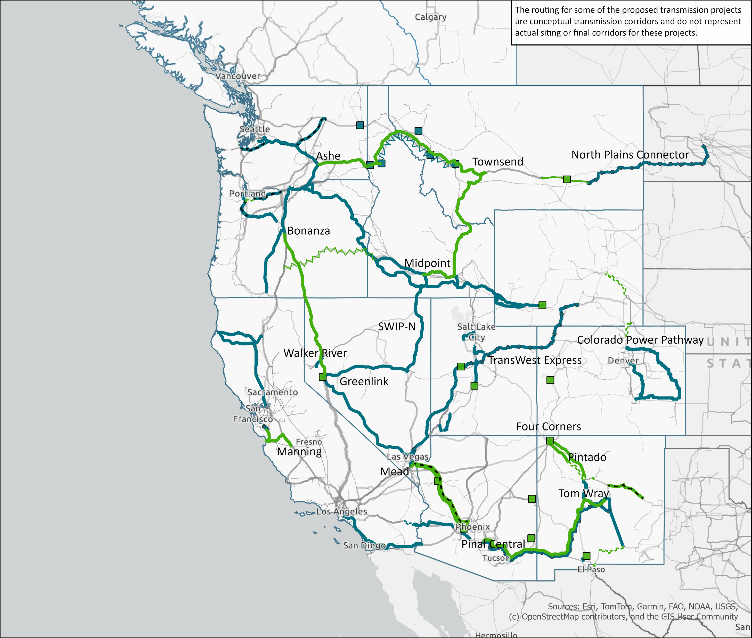
10-Year Horizon Portfolio:
All Upgrades
10-Year Transmission Portfolio
(Color)
Planned Projects
Upgrades Identified by WestTEC
Upgrade Type
(Pattern)
New AC Line
New DC Line
Reconductor
Rebuild
Uprate
Substation Upgrade
Existing Transmission Layer
230kV
…
500kV

Slide 9
10-year Horizon Portfolio Summaries and Cost Estimates
The 10-Year Horizon portfolio includes over 12,600 miles of regionally-significant upgrades or additions with a total cost of ~$60 billion
About two-thirds of these line miles meet the criteria of planned projects according to the WestTEC study plan
  Nearly 20% of these are under-construction or are nearing construction
The remaining one-third of line miles represent upgrades identified as part of WestTEC transmission solutioning efforts
Transmission Project Category |  | Project Count | Total Line Miles | Total Estimated Cost ($M)
Planned upgrades in Portfolio |  | 73 | 9,358 | $46,648
Upgrades identified by WestTEC in Portfolio | Reliability-driven | 21 | 1,156 | $6,050
 | Deliverability-driven | 8 | 1,742 | $7,239
 | Economic-driven | 3 | 394 | $391
10-Year Horizon Portfolio Total |  | 105 | 12,650 | $60,328

Slide 10
WestTEC 20-Year Scenarios
 | Reference | Flux | Core
Narrative | A baseline scenario reflecting reasonably anticipated trends in load growth, technology, and policy | A high-growth scenario reflecting rapid changes in power demand and technology innovation | A moderate-growth scenario with select technology breakthroughs
Load Growth (2025-2045) | 2.2% per year (56% increase) | 3% per year (80% increase) | 2% per year (48% increase)
Technology Costs | Moderate innovation trajectory | Advanced innovation trajectory | Conservative innovation trajectory* (No Tax Credits) *Breakthroughs in Storage, Advanced Geothermal, Nuclear SMRs, and CCS
GHG Policies | Statutory | Statutory & voluntary | Statutory with 5-year compliance delay

Slide 11
Western Governor’s Association Transmission Permitting Task Force
Endorse WestTEC study
Establish a Governor-Led Regional Framework
Prioritize High-Impact Transmission Lines
Develop Predictable, Multi-State Permitting Schedules
Strengthen Cross-State Collaboration and Share Best Practices
Strengthen Local and Tribal Participation
Maintain Strong Federal Relationship

Slide 12
State activities with FERC Order 1920

Slide 13
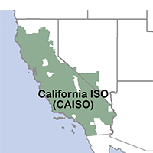
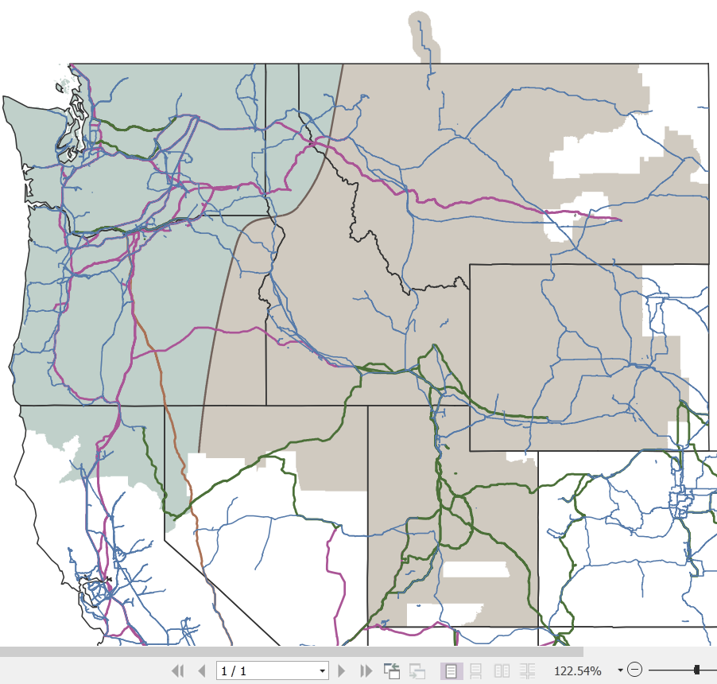
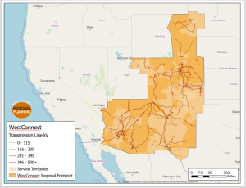
FERC Order No. 1920 Planning Regions

Slide 14
Relevant State Entites by Regions
NorthernGrid
CA Public Utilities Commission
ID Governor's Office of Energy and Mineral Resources
ID Public Utilities Commission
MT Public Service Commission
MT Department of Environmental Quality
OR Energy Facility Siting Council
OR Public Utilities Commission
OR Department of Energy
Public Utilities Commission of NV
UT Dept. of Natural Resources
UT Dept. of Water Resources
UT Office of Energy Development
UT Public Service Commission
WA Energy Facility Site Evaluation Council
WA Dept. of Commerce
WA Dept. of Ecology
WA Utilities and Transportation Commission
WY Dept. of Environmental Quality
WY Public Service Commission
WY Dept. of Game and Fish
WY Governor's Office
WY Office of Consumer Advocate
WestConnect
AZ Corporation Commission
CO Public Utilities Commission
MT Public Service Commission MT Department of Environmental Quality
NE Public Regulation Commission
NM Public Regulation Commission
NM State Land Office
NM Energy, Minerals, and Natural Resources Department
NM Renewable Energy Authority
Public Utility Commission of TX
SD Public Utilities Commission
UT Dept. of Natural Resources
UT Dept. of Water Resources
UT Office of Energy Development
UT Public Service Commission
WY Public Service Commission

Slide 15
1920 Ad Hoc Committee timeline review
June 2025
States provide feedback to planning regions on their ex ante methods and determine to undertake the development of their own proposal
January 2025
The CREPC 1920 Ad Hoc Committee launches, adopts charter, and designates co-chairs
Spring 2026
States provide feedback to planning regions on their planning proposals
April 2025
Draft State Agreement Process (SAP) adopted
October 2025
Draft ex ante cost allocation method adopted
April 2026
States vote to submit the finalized SAP and ex ante proposals to FERC

Slide 16
Final States’ Ex Ante Method Proposal
Three buckets
  Subscription: Utilities, generators, etc., acquire capacity on the project or projects (pre- and post- benefit quantification and zonal applications; see subscriber pays and opt-in)
  Quantified benefits: Utility-allocated costs based on proportionate benefits using 7 FERC benefits
  Zonal allocation using power flow analysis: Utility-allocated costs based on DFAX analysis and load-weighted proportions.
Assignment of costs requires more than de minimis costs, defined as 2% or less of the total project costs determined by combined benefit quantification and zonal elements
Utility receives transmission rights if allocated costs, which can be resold
There is always an option for states/generators/non-jurisdictional utilities to volunteer to pay a share of the costs of a project or projects
opt-in
XX% of remaining costs allocated zonally using power flow analysis, where…
Locational/voltage allocation method
Quantified beneficiary pays
XX% of remaining costs allocated through quantification of benefits, where…
XX% of a project cost allocated on a subscriber pays basis
Subscriber pays

Slide 17
Final States’ State Agreement Process Proposal
Scope: Applies to all transmission projects selected for the purposes of cost allocation by NorthernGrid and WestConnect
Timing: Eligible to launch when a project(s) is identified for possible selection by NorthernGrid or WestConnect; once any projects are selected states have 6 months to agree on an ex post method
State representation: Each state utility regulatory commission that regulates a utility or utilities that would be assigned costs via the ex ante cost allocation methodology or an identified ex post method would have one vote on the SAP cost allocation approach
“Agreement” defined as unanimous for a single project; and as 75% majority + states regulating utilities with 75% of total estimated costs for a portfolio of projects
Non-jurisdictional issues: States may only allocate costs to FERC-jurisdictional utilities and enrolled non-FERC-jurisdictional utilities. If states determine that a proposed transmission project(s) substantially benefits one or more non-FERC-jurisdictional utilities, the states may recommend to NorthernGrid/WestConnect that the transmission providers in that region rescind their decision to select that project or projects for purposes of cost allocation.

Slide 18
Questions?
Robin Arnold
Director of State, Federal, and International Affairs rarnold@westernenregyboard.org

