Slide 1


NV Energy’s Integrated Resource Plan (IRP) Transmission Overview
(Docket No. 26-05007)
August 25, 2026
Regional Transmission Coordination Task Force
Paul Maguire, engineering manager PUCN Staff
Gary Cameron, Regulatory Engineer PUCN Staff

Slide 2
Transmission Components of the IRP
There are essentially five (5) main transmission components to the IRP:
  Updates on Previously Approved Projects (mainly the 500 KV Greenlink Project)
  New Transmission Projects to connect the 21+ new renewable energy and battery storage projects (approx. 10 GW combined)
  New Transmission Projects to connect the 1200 to 1500 MW of new conventional natural gas peaking generation at the existing Ft. Churchill Power Station (Yerington, NV)
  New Transmission Projects for reliability and North American Electric Reliability Corporation (NERC) compliance
  New Transmission and High Voltage Distribution Projects to connect large load customer requests

Slide 3
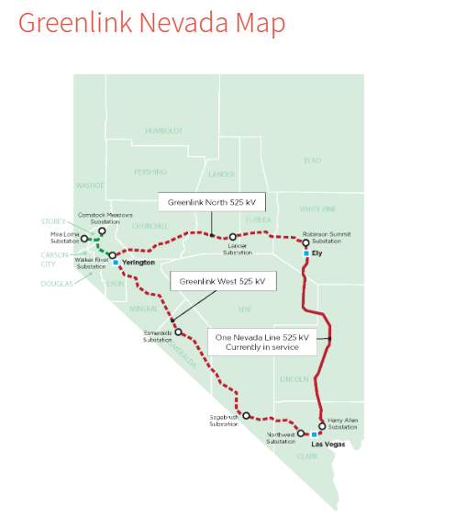
Previously Approved Projects
Greenlink West, Greenlink North and Common Ties:
  Greenlink West delayed till the end of 2027
  Greenlink North delayed till the end of 2028
  Project cost is estimated to be between ($4.5 and $5.0 billion). The is up from the initial estimates in 2021 of $2.1 to $2.4 billion
  Both Greenlink West and Greenlink North are still not fully permitted

Slide 4
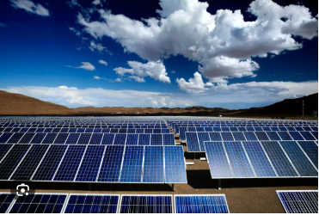
New Transmission Projects to Support 21+ New Renewable Energy Projects
  21+ new Renewable Projects
    Solar and Batteries
    Geothermal Resources
    Standalone Batteries
    Long Duration Storage
  Transmission associated with network upgrades to allow for the connection of these projects.
  Total estimated transmission costs $416 million

Slide 5
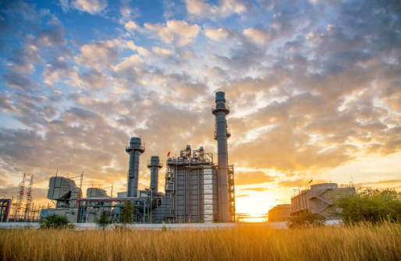
Transmission Projects to connect 1200 to 1500 MW of New Conventional Peaking Generation
  1200 MW to 1500 MW of projects proposed
  Natural gas fired simple cycle generation
  Located at the existing Ft Churchill Power Station
  Total estimated transmission costs $485 million

Slide 6

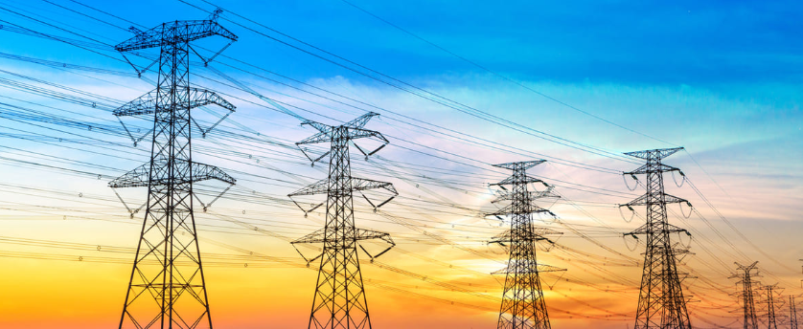
Transmission Projects for Reliability and NERC Compliance
  Approximately five (5) projects outlined
  Total estimated transmission costs $140 million

Slide 7

Transmission and High Voltage Distribution Projects to connect large load customer.
  Approximately 17 total projects
  Located in both Northern and Southern Nevada
  Total estimated costs $1.9 billion

Slide 8
Questions?

