Slide 1
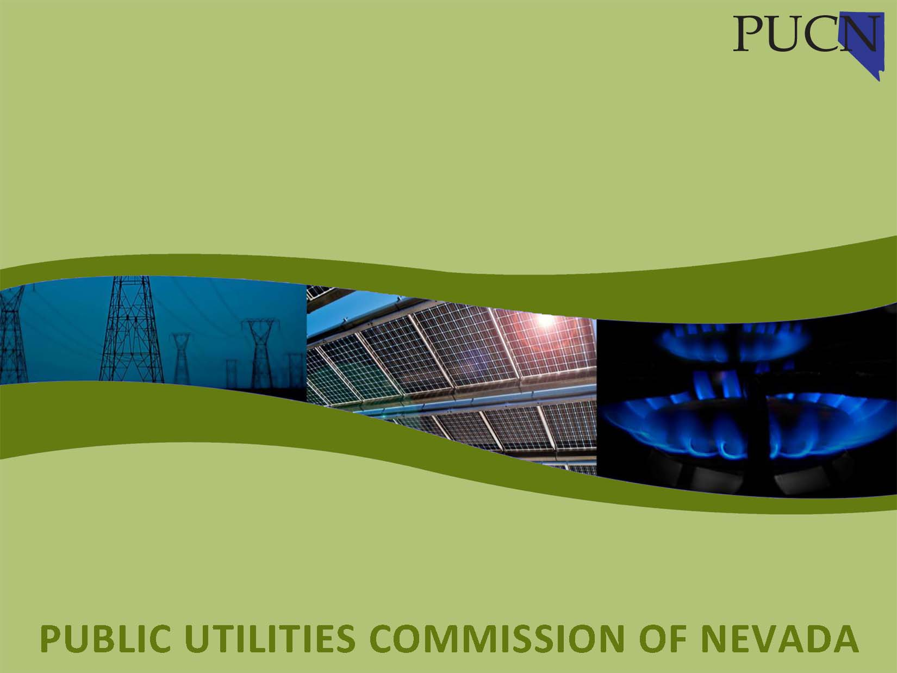
PUCN Regional Transmission Activity
Commissioner Tammy Cordova
For the Nevada Regional Transmission Task Force
On August 25, 2026

Slide 2

Discussion Topics
Overview of the Commission
Commission Docket No. 23-10019
Other relevant Commission dockets to include Integrated Resource Plans
  Docket No. 24-05041 Joint Application of Nevada Power Company d/b/a NV Energy and Sierra Pacific Power Company d/b/a NV Energy for approval of their 2025-2044 Triennial Integrated Resource Plan and 2025-2027 Energy Supply Plan.
  Docket No. 25-10025 Joint Application of Nevada Power Company d/b/a NV Energy and Sierra Pacific Power Company d/b/a NV Energy for approval of an amendment to their 2025-2027 Energy Supply Plan to participate in the Extended Day-Ahead Market.
  Docket No. 26-05007 Joint Application of Nevada Power Company d/b/a NV Energy and Sierra Pacific Power Company d/b/a NV Energy for approval of their 2027-2046 Triennial Integrated Resource Plan and 2027-2029 Energy Supply Plan.
Regional Committees in which the Commission participates

Slide 3
The Public Utilities Commission of Nevada
The Public Utilities Commission of Nevada (PUCN) is a regulatory agency that ensures investor-owned utilities comply with laws enacted by the Nevada Legislature.
The PUCN’s basic regulatory duties, as defined by the Legislature (NRS 704.001), include:
To provide for fair and impartial regulation of public utilities.
To provide for the safe, economic, efficient, prudent and reliable operation and service of public utilities.
To balance the interests of customers and shareholders of public utilities by providing public utilities with the opportunity to earn a fair return on their investments while providing customers with just and reasonable rates.
The PUCN regulates approximately 400 investor-owned utilities in Nevada but does not rate-regulate municipal-owned utilities. The PUCN has limited authority over utility cooperatives. The PUCN does not regulate the rates or service quality of utility cooperatives.

Slide 4
The Public Utilities Commission of Nevada
      The Commission includes 3 Commissioners appointed by the Governor to four-year staggered terms. The Executive Director, the General Counsel and his staff, and the Policy Analysis division directly support the Commissioners.
      The Commission has 104 FTE. This includes the highly professional and technical Regulatory Operations Staff who investigate all matters brought before the Commission.
      The Commission makes decisions based on an evidentiary record and a formal hearing process. Many of the Commission’s contested cases have statutory effective dates.
      The Commission draws its authority from the laws enacted by the Nevada Legislature, which are primarily found in Chapters 703 and 704 of the Nevada Revised Statutes.

Slide 5

Docket No. 23-10019
Investigation regarding regional market activities in the western interconnection relevant to Nevada utilities’ obligations pursuant to NRS Chapter 704.
Initiated due to passage of NRS 704.79887 (1):
Except as otherwise provided in subsection 2, the Commission shall require every transmission provider in this State to join a regional transmission organization on or before January 1, 2030.
Docket conducted in three phases:
Information and process to evaluate joining a day ahead market of a regional transmission organization
Information and process to evaluate a waiver or delay pursuant to NRS 704.79887 (2)
Information and process to evaluate joining a regional transmission organization.

Slide 6
Docket No. 23-10019 Phase One
The Commission adopted a Report on July 9, 2024. The Report directed that a request to join a day ahead market be presented in an Energy Supply Plan amendment and include information responsive to 13 criteria (with subparts).
NV Energy filed an Application on October 22, 2025. 25-10025
Joint Application of Nevada Power Company d/b/a NV Energy and Sierra Pacific Power Company d/b/a NV Energy for approval of an amendment to their 2025-2027 Energy Supply Plan to participate in the Extended Day-Ahead Market.
The Commission issued a Modified Final Order on May 27, 2026, approving NV Energy’s request to join the CAISO’s Extended Day Ahead Market (“EDAM”). The Order outlined an expected Fall 2028 time for NV Energy to join EDAM.

Slide 7
Docket No. 23-10019 Phase One
The Commission’s Modified Final Order found the following factors supported NV Energy joining EDAM:
Positive experience with the WEIM and the lower implementation costs for EDAM due to participation in WEIM
The connectivity with the EDAM footprint and the overall connectivity of EDAM and WEIM participants
Projected customer benefits
CAISO governance structure and CAISO’s ability to respond with targeted, expedited stakeholder processes
Potential to deploy new technologies related to compliance with FERC Order 2222.
In particular, the Order noted that many of the existing and planned transmission facilities were interties between NV Energy and other projected EDAM participants.
Also of note are the Pathways Step 2 and the Regional Organization for Western Energy (“ROWE”).

Slide 8

Docket No. 23-10019 Phase Two
NRS 704.79886 (2) contemplates a waiver or delay of the requirement in Sub (1):
Upon application by a transmission provider, the Commission may waive or delay the requirement in subsection 1 if:
(a) The transmission provider files an application with the Commission on or before January 1, 2027, requesting the waiver or delay;
(b) The transmission provider demonstrates:
(1) That the transmission provider has made all reasonable efforts to comply with the requirement but is unable to find a viable and available regional transmission organization that the transmission provider can join on or before January 1, 2030; or
(2) That it would not be in the best interests of the transmission provider and its customers to join a regional transmission organization on or before January 1, 2030; and
(c) The Commission determines that it is in the public interest to grant the requested waiver or delay.

Slide 9
Docket No. 23-10019 Phase Two
On July 29, 2026, the Commission issued an Order accepting a Report regarding any request by NV Energy to waive or delay the requirement to join a regional transmission organization.
Under NRS 704.79886, this request for waiver or delay must be filed with the Commission no later than January 1, 2027.
The Report acknowledged that all participants in this Phase of the Docket agreed that there does not currently exist a regional transmission organization for NV Energy to join that meets the definition in NRS 704.79882.
NRS 704.79882 “Regional transmission organization” defined. “Regional transmission organization” means an entity established for the purpose of coordinating and efficiently managing the dispatch and transmission of electricity among public utilities on a multistate or regional basis that:
1. Is approved by the Federal Energy Regulatory Commission;
2. Effectuates separate control of transmission facilities from control of generation facilities;
3. Implements, to the extent reasonably possible, policies and procedures designed to minimize pancaked transmission rates;
4. Improves service reliability within this State;
5. Achieves the objectives of an open and competitive wholesale electric generation marketplace, elimination of barriers to market entry and preclusion of control of bottleneck electric transmission facilities in the provision of retail electric service;
6. Is of sufficient scope or otherwise operates to substantially increase economical supply options for customers;
7. Has a structure of governance or control that is independent of the users of the transmission facilities, and no member of its board of directors has an affiliation with a user or with an affiliate of a user during the member’s tenure on the board so as to unduly affect the regional transmission organization’s performance;
8. Operates under policies that promote positive performance designed to satisfy the electricity requirements of customers;
9. Has an inclusive and open stakeholder process that does not place unreasonable burdens on or preclude meaningful participation by any stakeholder group;
10. Promotes and assists new economic development in this State; and
11. Is capable of maintaining real-time reliability of the transmission system, ensuring comparable and nondiscriminatory access and necessary service, minimizing system congestion and further addressing real or potential transmission constraints.

Slide 10

Docket No. 23-10019 Phase Three
Next up….
A discussion of how the state will proceed with its regional transmission organization plan given the ongoing developments in the western interconnection.

Slide 11
NV Energy’s Integrated Resource Plans
Pursuant to NRS 704.741 et al, the integrated resource includes MANY parts:
Load Forecast which includes historical and future data
Three-year Energy Supply Plan which includes a fuels plan and risk mitigation plan
Supply Plan which includes all current and projected generation resources
Transmission Plan
Financial Plan including rate impacts of other parts of the IRP
Distributed Resources Plan
Renewable Energy Plan to ensure Nevada’s Renewable Energy Obligations are met
Demand Side and Energy Efficiency Plan
Transportation Electrification Plan

Slide 12
NV Energy’s Integrated Resource Plans
The two most recent IRP’s were as follows:
  Docket No. 24-05041 Joint Application of Nevada Power Company d/b/a NV Energy and Sierra Pacific Power Company d/b/a NV Energy for approval of their 2025-2044 Triennial Integrated Resource Plan and 2025-2027 Energy Supply Plan.
  NV Energy’s Application was filed with the Commission on May 31, 2024, and an Order on Reconsideration was issued on February 18, 2025, reaffirming the Commission’s December 27, 2024, Order.
  Docket No. 26-05007 Joint Application of Nevada Power Company d/b/a NV Energy and Sierra Pacific Power Company d/b/a NV Energy for approval of their 2027-2046 Triennial Integrated Resource Plan and 2027-2029 Energy Supply Plan.
  NV Energy’s Application was Filed on May 6, 2026, and the Application is currently under review. The Regulatory Operations Staff will join us shortly to give an overview of the requests in the Transmission Plan in Docket No. 26-05007.

Slide 13
Relevant Regional Committees
Western Energy Markets Body of State Regulators
Current Representative, Commission Chair Hayley Williamson
The Western Energy Markets Body of State Regulators (BOSR) was established in September 2015, as a part of the governance proposal adopted by the Board of Governors of the California Independent System Operator (CAISO) to address the regional nature of its energy imbalance market (EIM). The BOSR is comprised of one commissioner from each of the state public utilities commissions in which a regulated load-serving utility participates or plans to participate in the CAISO EIM or Extended Day-Ahead Market (EDAM). The BOSR provides a forum for state commissioners to (1) select a voting member of the Western Energy Markets (WEM) Governing Body Nominating Committee, (2) learn about and discuss the EIM, EDAM, and CAISO markets, and (3) express a common position in CAISO stakeholder processes or to the WEM Governing Body on EIM and/or EDAM issues.
The EIM and EDAM allows western balancing authorities outside of the CAISO footprint to participate in CAISO’s real-time and extended day-ahead wholesale energy market, without fully integrating into the CAISO balancing authority. EIM and EDAM participants buy and sell power in the wholesale energy market close to the time electricity is consumed, and in the day-ahead, respectively.

Slide 14
Relevant Regional Committees
WPP Western Resource Adequacy Program
Committee of State Representatives
Current Representative, Commissioner Tammy Cordova
The Committee of State Representatives (COSR) is a standing committee of the Western Resource Adequacy Program (WRAP), a first-of-its-kind reliability program in the West operated by the Western Power Pool (WPP). The WRAP tariff was approved by the Federal Energy Regulatory Commission (FERC) at the beginning of 2023, and the COSR was established soon after in April 2023 in accordance with the WRAP Bylaws. The COSR aims to support state and provincial engagement in the WRAP and share those valuable perspectives on pertinent program matters. The COSR will advise the WPP Board of Directors, Program Review Committee (PRC), Resource Adequacy Participants Committee (RAPC), any working groups or task forces, and the Federal Energy Regulatory Commission (FERC) on matters related to WRAP governance, program design, and operations.
The COSR is composed of one representative from each state or provincial jurisdiction that regulates at least one Participant. State and provincial representatives are nominated by the Chair or President of their respective public utility commissions and may include representatives from the state or provincial energy offices or state or provincial funded consumer advocates. The COSR operates in a public setting and welcomes other regional stakeholders to attend committee meetings to better foster engagement and collaboration.

Slide 15
Relevant Regional Committees
Western Interconnection Regional Advisory Body
Current Representative, Director James Humm, Nevada GOE
In 2006, upon petition of ten western governors and in accordance with Section 215(j) of the Federal Power Act (FPA), the Federal Energy Regulatory Commission (FERC) created the Western Interconnection Regional Advisory Body (WIRAB). As a Section 215(j) regional advisory body, WIRAB has the authority to advise FERC, the North American Electric Reliability Corporation (NERC), and the Western Regional Entity (i.e., WECC) on matters pertaining to electric grid reliability in the Western Interconnection. For example, WIRAB advises these entities on whether reliability standards proposed to apply within the region and WECC governance and budgets are just, reasonable, not unduly discriminatory or preferential, and in the public interest.
WIRAB’s membership is comprised of all states and provinces with load served in the Western Interconnection. The FPA provides that, as a body organized on an Interconnection-wide basis, FERC may give deference to the advice of WIRAB. WIRAB works hard to achieve consensus among all its members before submitting advice on important reliability matters. WIRAB is unique because it speaks with a single common voice, on behalf of all states and provinces in the Western Interconnection, regarding electric system reliability matters.

Slide 16
Relevant Regional Committees
Committee on Regional Electric Power Cooperation
Current Representatives, Commission Chair Hayley Williamson and
Director James Humm, Nevada GOE
The Committee on Regional Electric Power Cooperation (CREPC) was established in 1982. CREPC is a joint committee of the Western Interstate Energy Board (WIEB) and the Western Conference of Public Service Commissioners (WCPSC). In November 2022, WIEB and WCPSC adopted a Charter articulating the scope, role, and membership of the Committee.
CREPC is composed of an energy office official and a regulatory utility commissioner from each of the Western states and Canadian provinces and focuses on electric power system policy issues that require regional cooperation in the West. All state and provincial agency personnel, not just designated CREPC Members, are invited and encouraged, to participate in meetings and discussions.

Slide 17
Relevant Regional Committees
CREPC Transmission Collaborative,
including the 1920 Ad Hoc Committee
The CREPC Transmission Collaborative (CREPC TC) is an informal working group of CREPC designed to focus on regional transmission issues. The CREPC TC provides a standing space for CREPC members and staff to collaborate on transmission coordination and development in the West through sharing viewpoints and information from the diversity of Western states and provinces.
CREPC TC bi-monthly meetings are only for state and provincial utility commissioners, energy office directors, and their staff. As CREPC TC evolves and undertakes various projects, there will be periodic open meetings to engage stakeholders on these efforts and opportunities for CREPC TC to garner input and receive feedback.
Initial work of the CREPC TC will focus on facilitating state and provincial input into Western Power Pool’s Western Transmission Expansion Coalition (WestTEC) as it develops a west-wide transmission plan, and to coordinate state and provincial input for a CREPC-led effort to explore transmission cost allocation frameworks for the West. Other regionally significant transmission issues may be discussed in the CREPC TC as they arise.
The 1920 Ad Hoc Committee was formed by CREPC to help facilitate the relevant state entities’ (RSE) participation in the discussions taking place as part of the State Engagement Period in both NorthernGrid and WestConnect. The Committee consists of representatives from each of the RSEs in both planning regions.

Slide 18
Questions
Commission Contacts:
www.puc.nv.gov
Mailing/Physical Address | Phone, Fax & Office Hours
1150 E. William Street Carson City, NV 89701-3109 | Phone: (775) 684-6101 Fax: (775) 684-6110 Office Hours: Monday - Friday, 8 a.m. - 5 p.m.
Mailing/Physical Address | Phone, Fax & Office Hours
9075 W. Diablo Drive, Suite 250 Las Vegas, NV 89148 | Phone: (702) 486-7210 Fax: (702) 486-7206 Office Hours: Monday - Friday, 8 a.m. - 5 p.m.

