Slide 1
SB448 Regional Coordination Task Force
Charlie Pottey – Director, Transmission Planning
Scott Kaufmann – Vice President, Transmission
September 22, 2026

Slide 2
NV Energy Transmission Planning
NV Energy Transmission Planning Department has 16 employees. 2 Directors, 1 Manager, 11 Engineers, and 2 Student Interns.
Responsible for all Transmission Planning activities including:
        NERC Reliability Studies and Compliance
        Integrated Resource Planning – Transmission Plan
        Generator Interconnection Requests
        Transmission Service Requests
        Load Addition Requests
        Regional Transmission Planning
        FERC Transmission Planning Requirements and Compliance

Slide 3
NV Energy Transmission Operations
Transmission constructs, maintains and operates a safe, reliable and NERC compliant electric system for the benefit of our customers and the western interconnection
  Grid Operations – transmission, balancing, distribution, and energy imbalance market
  Substation Operations
  Telecommunication Operations
  Operations Technology

Slide 4
NV Energy Transmission Planning Process
Attachment K of the Company's Open Access Transmission Tariff
FERC-approved process delineated in components:
  Local
  Regional
  Interregional
Regional and Interregional Plans are coordinated with the NorthernGrid members: Avista, BHE Canada, BPA, Chelan County, Grant County, Idaho Power, ITC Holdings, NorthWestern, PacifiCorp, Portland General Electric, Puget Sound Energy, Seattle City Light, Snohomish County, and Tacoma Power

Slide 5
Local Transmission Planning
Local Transmission Study Plan
        NERC Reliability Studies / TPL-001-5
        Integrated Resource Plan – Transmission Plan
        Study Request
        Generator Interconnection
        Network Studies (Designated Network Resource)
        Transmission Service
        Load Additions
        Area Master Plans
Stakeholder Input – Semi-Annual Transmission Planning Attachment K Stakeholder Meetings

Slide 6
Regional Transmission Coordination
Compliant with FERC Orders 890,1000 and 1920 (pending)
NorthernGrid regional Transmission Planning Process to produce a regional transmission plan every 2 years. Order 1920 Plan will be every 5 years
Coordinate with CAISO and WestConnect members on interregional planning
Participate in the Western Power Pool's WestTEC program to produce a west wide transmission needs study to support the future needs of the transmission grid

Slide 7
Public Power Transmission Planning Coordination
Most Public Power entities in Nevada are wholesale customers of NV Energy (Except VEA)
These entities take Network Integration Transmission Service (NITS) under NV Energy OATT
NV Energy studies the transmission needs of the NITS customers based on the 10-year load forecast they provide and plans required transmission additions
Based on previously-submitted requests, NV Energy will grant 681 MW of open access transmission tariff requests for northern Nevada import capacity upon Greenlink West completion

Slide 8
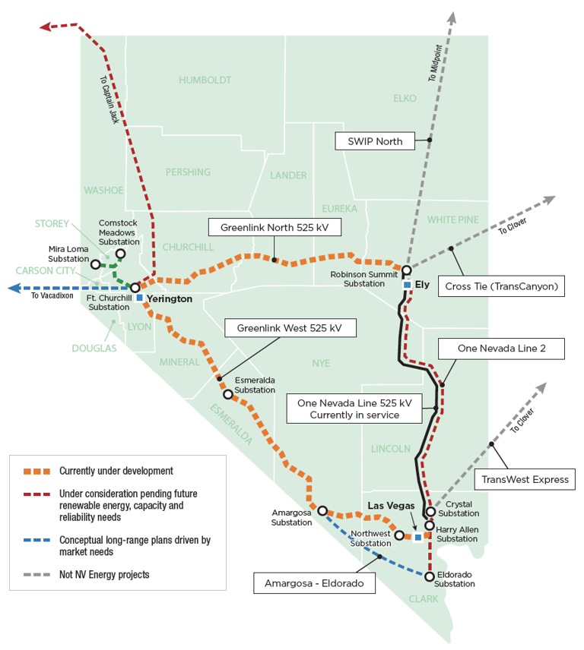
Regional Transmission Development

Slide 9
Regional Transmission Development Projects
Cross-Tie
  Cross-Tie is a 525 kV transmission line that is being developed by TransCanyon between the NV Energy’s Robinson Summit substation and the PacifiCorp Clover substation.
  NV Energy is coordinating with PacifiCorp and TransCanyon to identify benefits of the project to native load and the western region.
  The project was selected in draft WestTEC 20-year plan
ON Line #2
  ON Line #2 is a second 525 kV transmission line that could be developed by NV Energy between the NV Energy’s Robinson Summit substation and Harry Allen substation
  This project could be needed if both SWIP-North and Cross-Tie are developed
  The Bureau of Land Management accepted NV Energy’s application for renewal of ON Line 2 Grant Offer. The Grant Offer has been extended to 2028
Walker River – NOB - Bonanza 525kV transmission line
  Walker River-NOB-Bonanza is a 525 kV line from NV Energy’s Walker River substation to BPA’s Bonanza Substation. The project will include an intermediate substation at the Nevada-Oregon Border (NOB)
  Jointly being evaluated by BPA and NV Energy with a proposed ISD of 2035.
  The line would provide additional transfer capacity between NV Energy system, Desert Southwest, and the Pacific Northwest. Would allow for the development of additional renewable resources and diversity exchanges.
  Would increase the northern Nevada system import limit.
  The project was selected in the WestTEC 10-year plan.

Slide 10
Regional Transmission Development Projects
Amargosa –Bighorn- Eldorado/Mead 525kV transmission line
  NV Energy has BLM grant offer to build Bighorn – Eldorado 525kV transmission line
  Amargosa – Bighorn transmission line was evaluated as an alternative in Greenlink West
  Bureau of Land Management has identified 22 gigawatts of renewable energy interest around Amargosa and Esmeralda Collector stations
  Amargosa-Bighorn – Eldorado/Mead 525kV transmission line will enhance capability to deliver additional renewable resources to Sothern Nevada, CAISO and the desert southwest
Walker River – Tesla 525kV transmission line
  NV Energy is evaluating if there is a need and if CAISO is interested in Walker River – Tesla 525kV transmission line
  Provide CAISO access to Greenlink Nevada system
  Fortify northern Nevada interconnection with CAISO/PG&E system in central/northern California
  LS Power has submitted this project to the NorthernGrid and CAISO regional planning process.
  The project was selected in draft WestTEC 20-year plan.
Gridliance West
  Gridliance contacted NV Energy transmission regarding their proposed Silverado project that anticipates 230 kV in the Amargosa Valley area. They are interested in identifying synergies between Greenlink West and Silverado
  Gridliance West has proposed plans for 230kV or 525kV upgrade to the CAISO
TransWest Express
  NV Energy conducted studies in response to the developer's transmission interconnection application
  Federal Energy Regulatory Commission granted TransWest authority to sell transmission service at negotiated rates
  The project is progressing based on recovery from contracts with energy supplier delivering into the California ISO and Los Angeles areas at Eldorado

Slide 11
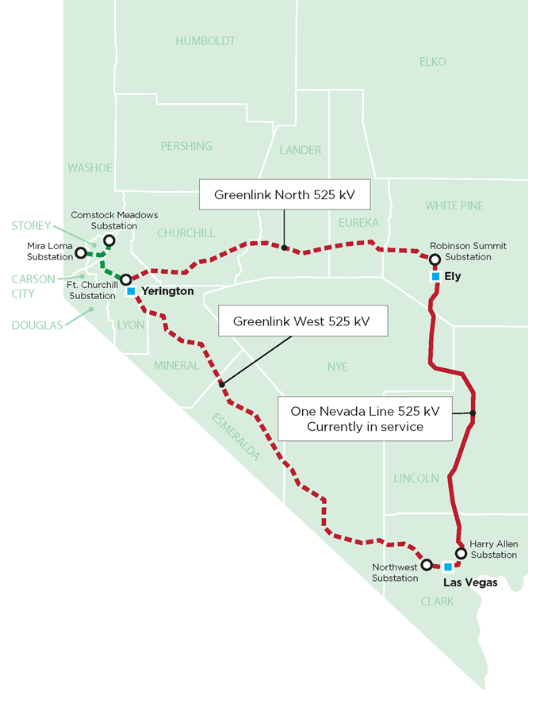
Greenlink Nevada Transmission Project
Greenlink West
  Walker River to Northwest 525 kV
  Northwest to Harry Allen 525 kV
  Northwest substation expansion
  Sagebrush and Esmeralda 525/230 kV collector substations
Greenlink North
  Walker River to Robinson Summit 525 kV
  Lander 525/230 kV collector substation
Common Ties
  Walker River 525-345-230-120 kV substation
  Walker River Mira Loma 345 kV
  Walker River to Comstock Meadows #1 345 kV
  Walker River to Comstock Meadows #2 345 kV
Benefits for customers and the state of Nevada
  Creates access to new areas of the state to develop affordable renewable energy resources
  Facilitates ability to meet Nevada’s renewable development and carbon-reduction goals
  Positions Nevada to benefit from renewable energy resource mix when future regional transmission projects interconnect at Robinson Summit
  Strengthens electric reliability for Nevada
  Aligns with long-term statewide economic growth both in northern and southern Nevada
  Positions Nevada as energy leader in western U.S.
  Increases transfer capacity between north and south and increases import and export capacity

Slide 12
SWIP-North Project Development
SWIP-North
  SWIP-North is a 525 kV transmission line that is being developed by LS Power between the NV Energy’s Robinson Summit substation and the Idaho Power’s Midpoint substation.
  The Transmission Use Agreement governs the ownership and use of the jointly owned transmission infrastructure between Midpoint and Eldorado.
  NV Energy is the sole BAA and operating agent for SWIP-N and ON-Line under the transmission use agreement
  CAISO Participation
  On December 14, 2023, the California ISO Board of Governors conditionally approved a plan to contract for use of a significant portion of GBT’s Capacity Entitlements on SWIP-N and ON-Line
  GBT will dedicate all of its Capacity Entitlements on SWIP-North and ON-Line to CAISO except for 500 MW of northbound Capacity Entitlements to be dedicated to Idaho Power
  Idaho Power Participation
  Idaho Power (IPC) and LS Power are pursuing a transaction pursuant to which GBT would make available to IPC 500 MW of GBT’s northbound Capacity Entitlement on SWIP-North and ON-Line
  Idaho Power’s 500 MW of northbound transmission capacity represents 22.83% of GBT’s total Capacity Entitlement
  These Capacity Entitlements would be made available to Idaho Power by way of two separate arrangements that would go into effect once SWIP-N is completed

Slide 13
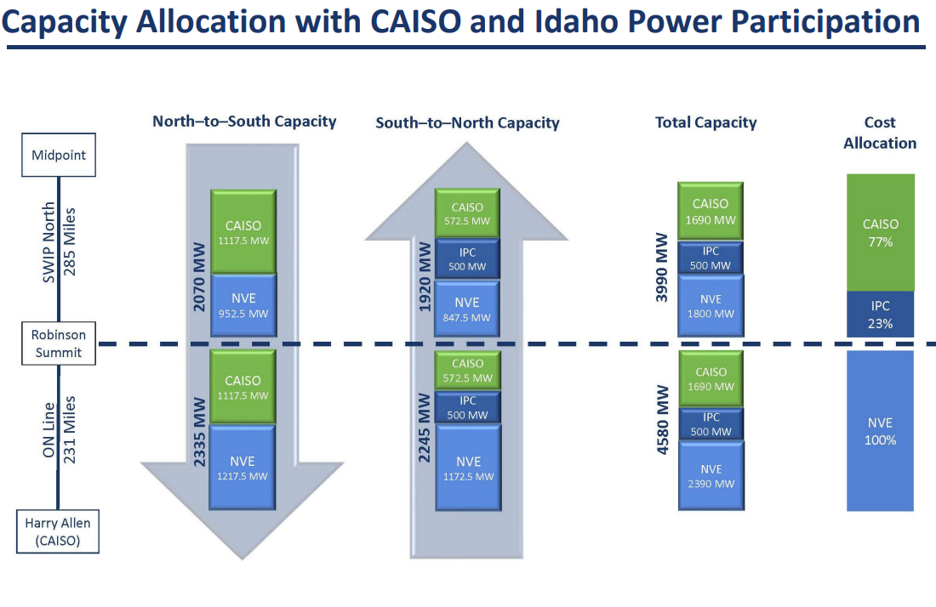
SWIP-North Transmission Rights

Slide 14
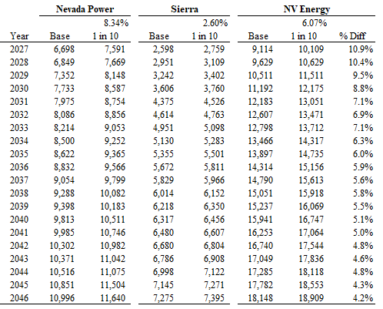
Retail Customer Load Forecast
Nevada Power & Sierra Pacific

Slide 15
Network Customer Load Forecast
NV Energy
NEVADA POWER COMPANY
SNWA-SB211, WYNN, MGM, Switch, Caesars, Overton, CRC/BMI, Circus Circus, Georgia Pacific, SLS, Air Liquide, Hard Rock LV (Mirage), Rio
Year | 2026 | 2027 | 2028 | 2029 | 2030 | 2031 | 2032 | 2033 | 2034 | 2035 | 2036
Max MW | 562 | 575 | 653 | 665 | 902 | 903 | 913 | 914 | 914 | 924 | 1013
SIERRA PACIFIC POWER COMPANY
City of Fallon, Truckee Donner Public Utilities District, Bonneville Power Administration - Harney Electric, Bonneville Power Administration - Wells Rural, Nevada Gold Mines - Barrick, Mt. Wheeler, Switch Limited, Caesars Entertainment, Peppermill, Liberty Utilities & Nevada Gold Mines - Newmont
Year | 2026 | 2027 | 2028 | 2029 | 2030 | 2031 | 2032 | 2033 | 2034 | 2035 | 2036
Max MW | 589 | 597 | 685 | 1783 | 2058 | 2250 | 3004 | 3253 | 3258 | 3260 | 3263

Slide 16
Grid Enhancing Technologies
Advanced conductors have been used by NV Energy since the early 2000s in order to achieve higher ratings via reconductor without having to replace structures.
  Common advanced conductors have been Aluminum Conductor Steel Supported (ACSS) in Southern Nevada and Aluminum Conductor Composite Core (ACCC) in Northern Nevada.
  Of the roughly 5,900 miles of NVE owned transmission, approximately 250 miles on 85 different lines is advanced conductor
Power Flow Control Devices – NV Energy has nine Phase Shifting Transformers (PST) currently in service. Two additional PST will be added as part of the SWIP-North project.

Slide 17
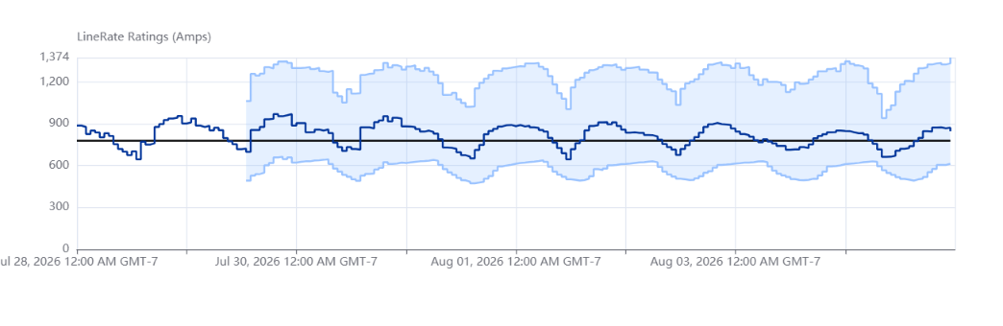
Grid Enhancing Technologies
Ambient adjusted ratings (AAR) are expected to go-live in fall 2027 and will adjust ratings in real-time and for a forecasted ten-day period (required by FERC Order 881)
Dynamic line ratings (DLR) are being evaluated on two Northern Nevada transmission lines to test technology, system integration, and benefits
  Early information shows an increase throughout much of the year. However, there is a risk of decreased ratings in some weather cases.
  Only useful for lines that are thermally limited.
Long-term planning using AAR and DLR will need to be thought through very carefully

