Slide 1
Grid Enhancing Technology Policy Options and Technical Considerations in Nevada
Julia Selker
Executive Director, WATT Coalition
jselker@gridstrategiesllc.com

Slide 2
Agenda
1. Background on ATTs technologies and value
2. Policy context – federal and state
3. Applied DLR

Slide 3
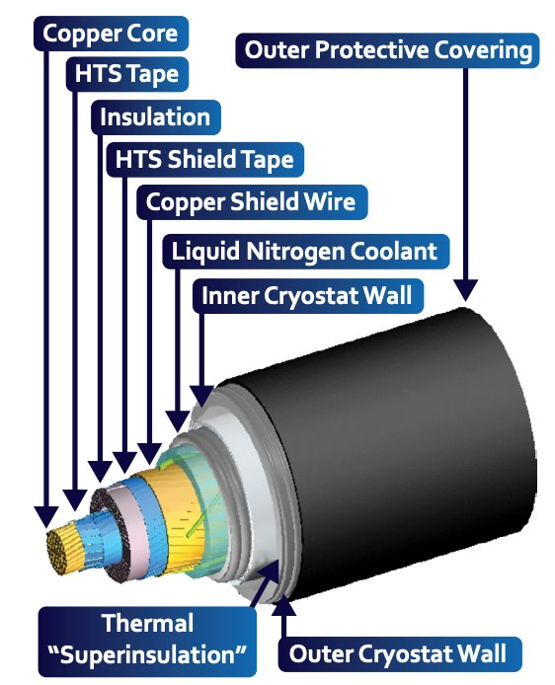

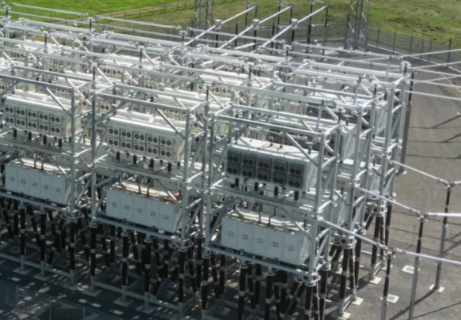
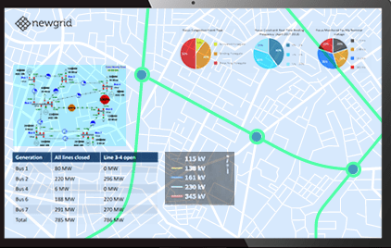
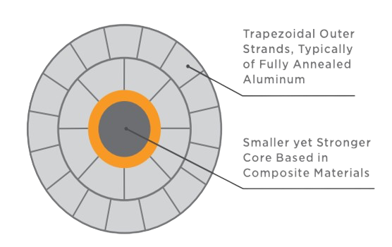
What are Advanced Transmission Technologies?
Advanced Transmission Technologies (ATTs) are technologies that can cost-effectively increase the capacity, efficiency, reliability and/or safety of power lines faster than traditional grid infrastructure and at lower cost or with higher net benefits.
There are two types of ATTs…
Grid Enhancing Technologies (GETs)
High Performance Conductors (HPCs)
Dynamic Line Ratings
Advanced Power Flow Control
Topology Optimization
Carbon Core Conductors
Superconductors

Slide 4
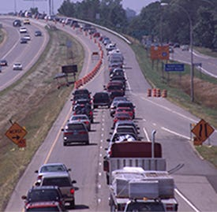










Grid Enhancing Technologies:
Large load!

Slide 5
Benefits of Grid Enhancing Technologies (GETs) and High Performance Conductors (HPCs)
GETs can decrease congestion costs by up to 50%, at relatively low cost.
HPCs can double transmission capacity at approximately half the cost of building a new line.
GETs can double the capacity of new generation integrated into the existing transmission grid in months.
HPCs can use existing rights-of-ways, reducing permitting and construction times.
Cost
Savings
Greater Efficiency
Fast Upgrades
GETs can increase the utilization of high-voltage 345kV lines by 15-22%.
HPCs reduce energy losses by at least 20% for Composite / Carbon Core Conductors, and up to 80% for superconductors
6 Key Benefits
GETs can give operators new tools to manage reliability by unlocking the grid’s dynamic capabilities.
HPCs can decrease wildfire risk by reducing line sagging compared to traditional conductors.
Increased Capacity
Resilience & reliability
GETs can increase the power transfer capacity of existing transmission lines by 20%+ on average.
HPCs such as Composite / Carbon Core Conductors double transmission capacity, while superconductors can quintuple capacity.
Lower Land Impacts
GETs can defer the need for construction of new transmission infrastructure.
HPCs can expand transmission capacity using existing rights-of-way.

Slide 6
Policy context

Slide 7
Recommendations from the Nevada Regional Transmission Coordination Task Force in 2024
Nevada policymakers, including the PUCN, should provide oversight for Nevada utilities’ implementation of FERC Orders 1920 and 2023.
Nevada should support policies that result in greater use of GETs and advanced conductors as a means of increasing capacity on the existing transmission system.
Note that participation in organized wholesale markets may also better illuminate the value of ATTs (e.g. the cost of grid constraints becoming transparently priced as “congestion”).

Slide 8
FERC Policies for Advanced Transmission Tech
Order No. 881
Order No. 2023
Order No. 1920
Show-Cause Orders
December 2021
Line Ratings:
Mandates that RTOs accept DLR and that utilities use temperature-adjusted ratings.
July 2023
Generator Interconnection:
Requires the consideration of APFC and HPCs in generator interconnection. TTO and DLR are optional.
May 2024
Transmission Planning:
Requires APFC, DLR, HPCs and transmission switching (best identified with TTO) to be considered in regional plans and deployed if they would make assets more cost effective. Also includes a “right-sizing” requirement.
June 2026
ATTs Modeling
Requires RTOs to prove that they use models that can represent ATTs, and that ATTs are considered as solutions for load interconnection.

Slide 9
$1.9 billion in matching grants from DOE soon!
Speed to Power through Accelerated Reconductoring and other Key Advanced Transmission Technology Upgrades (SPARK)

Slide 10

23 states have passed ATTs laws as of July 2026
Policy momentum driven by:
Affordability: Transmission congestion and rising power prices
Load growth: Bipartisan interest in “speed-to-power” for data centers and advanced manufacturing
Accelerating federal impact: FERC Order Nos. 881, 2023, 1920, and open rulemaking on DLR are all moving slower than state policy

Slide 11
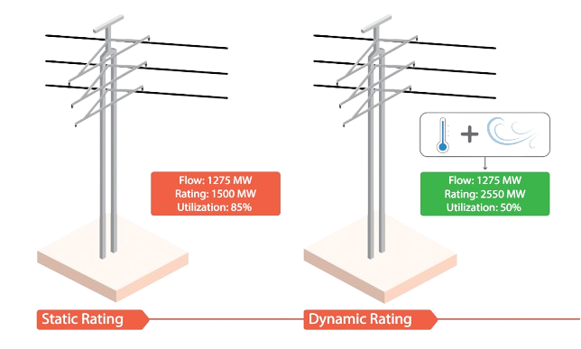
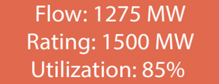
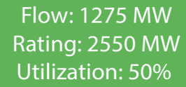
Dynamic Line Ratings in the desert?
Average capacity increases of 10-30%+

Slide 12
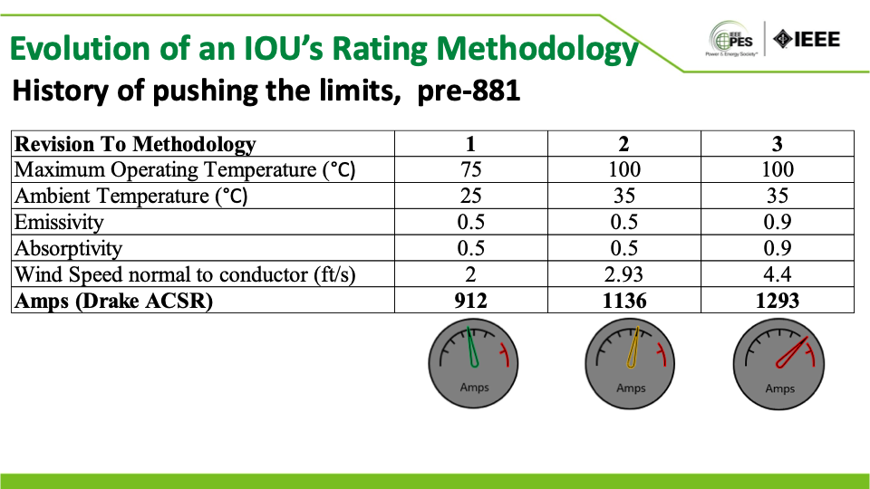
Source: Conductor Rating Considerations for AAR, Joe Coffey, Presented in 2024 IEEE PES General Meeting May 2024

Slide 13
DLR results from two lines in the same month
PPL, Presented to the WATT Coalition, May 2024

Slide 14
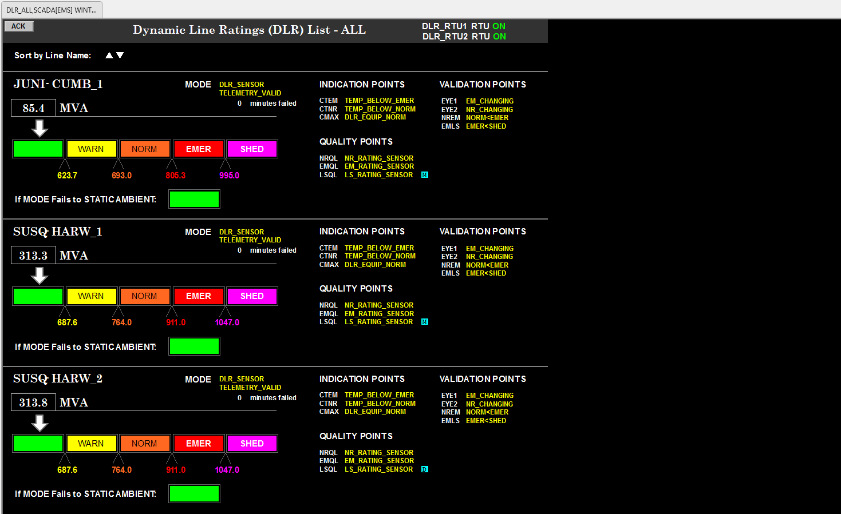
TMS Operator Display
Current line loading
Various DLR indication, validation, and quality points for situational awareness
Current real-time ratings
Rating Zone if DLR goes down
PPL, Presented to the WATT Coalition, May 2024

Slide 15
Thank you!
Questions and discussion welcome
Julia Selker
jselker@gridstrategiesllc.com

Slide 16
Appendix of random slides about GETs

Slide 17
Today’s grid has untapped capacity
Large load!

Slide 18
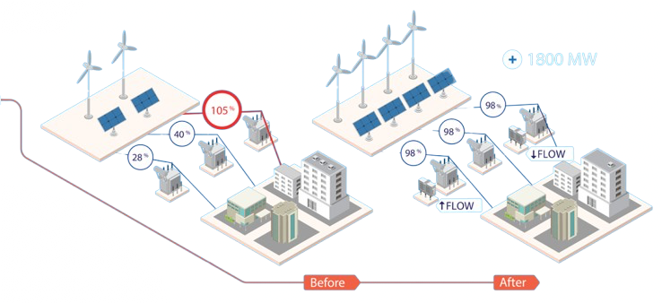
Advanced Power Flow Control
Georgia Power and PG&E find 100MW+ each
+ 1800 MW

Slide 19
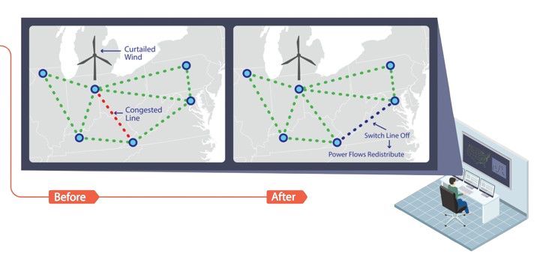
Transmission Topology Optimization
SPP released 845 MW of stranded generation

Slide 20
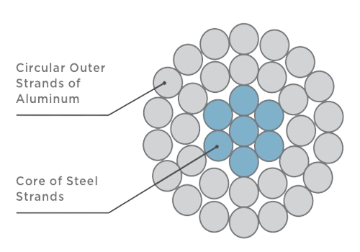

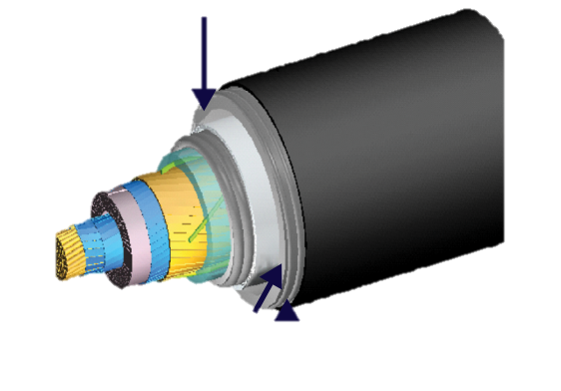
Conductor technology has evolved beyond traditional ACSR/ACSS to “High Performance Conductors” (HPCs)
Evolution of conductors
ACSR
ACSS (RW/TW)
HPCs (Carbon/composite core and superconductors)
Trapezoidal aluminum conductors
HTS tape
Galvanized steel core
Thermal “Superinsulation”
Outer cryostat wall
Additional Capacity
(Compared to ACSR)
150-200%
150-300%
500-1,000%
Efficiency
(Compared to ACSR)
2-20%
20-40%
50-80%
Line sag
Thermal sag
Thermal sag
10% thermal sag
No thermal sag

Slide 21



Federal policies: Advanced Transmission Technologies (ATTs)
Org.
Action
Description
Requires FERC to institute incentives (yet to be implemented)
Federal Power Act Section 219(b)3 (2005)
LPO, IIJA, and IRA funding
SPARK = $1.9 B in matching funds
Order No. 881 (2021)
Requires Ambient Adjusted Ratings
Order No. 2023 (2023)
Requires ATTs consideration in gen interconnection (DLR optional)
Order No. 1920 (2024)
Requires ATTs consideration in planning
Show Cause Orders
RTOs must study ATTs proactively

Slide 22
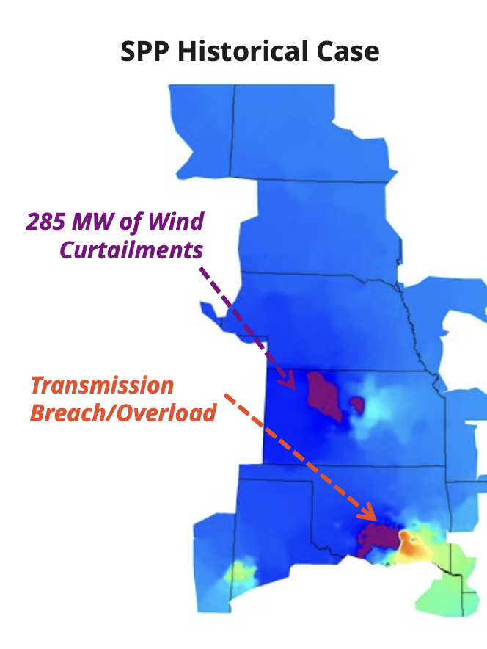
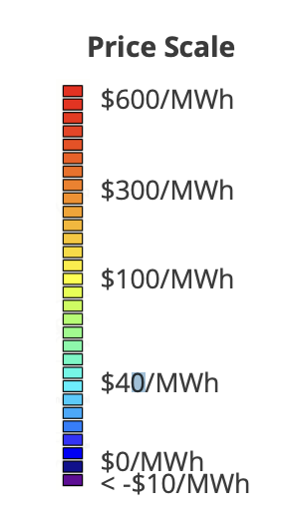
Reduce grid congestion by 40%+
2x interconnection
NewGrid presentation to FERC

Slide 23
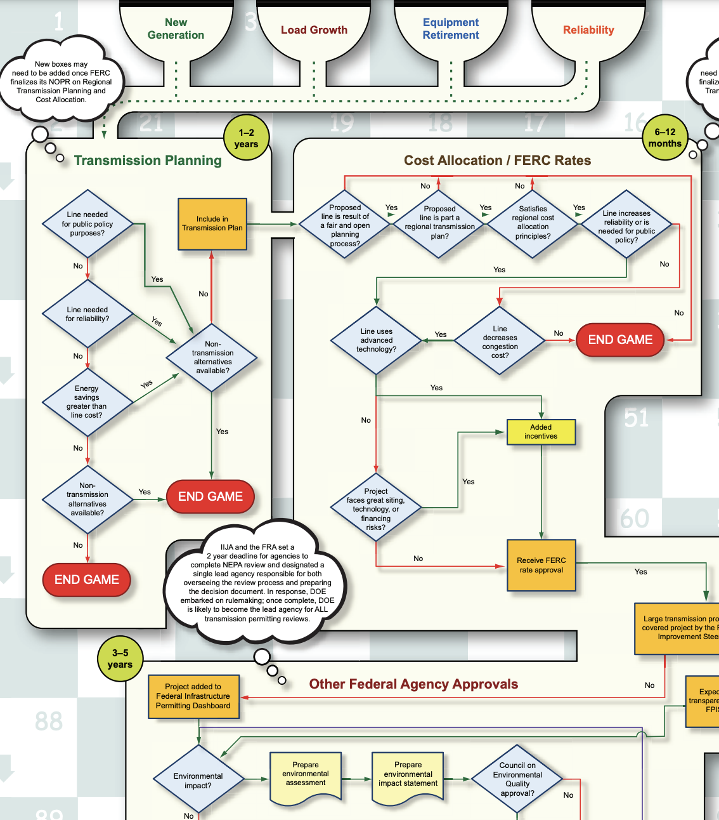
GETs deploy in months
For cheap!
1/20-1/200th the cost
NEMA 2024, continues for 2 more pages
Notes:
As you are on this rollercoaster – deploy GETs!

Slide 24

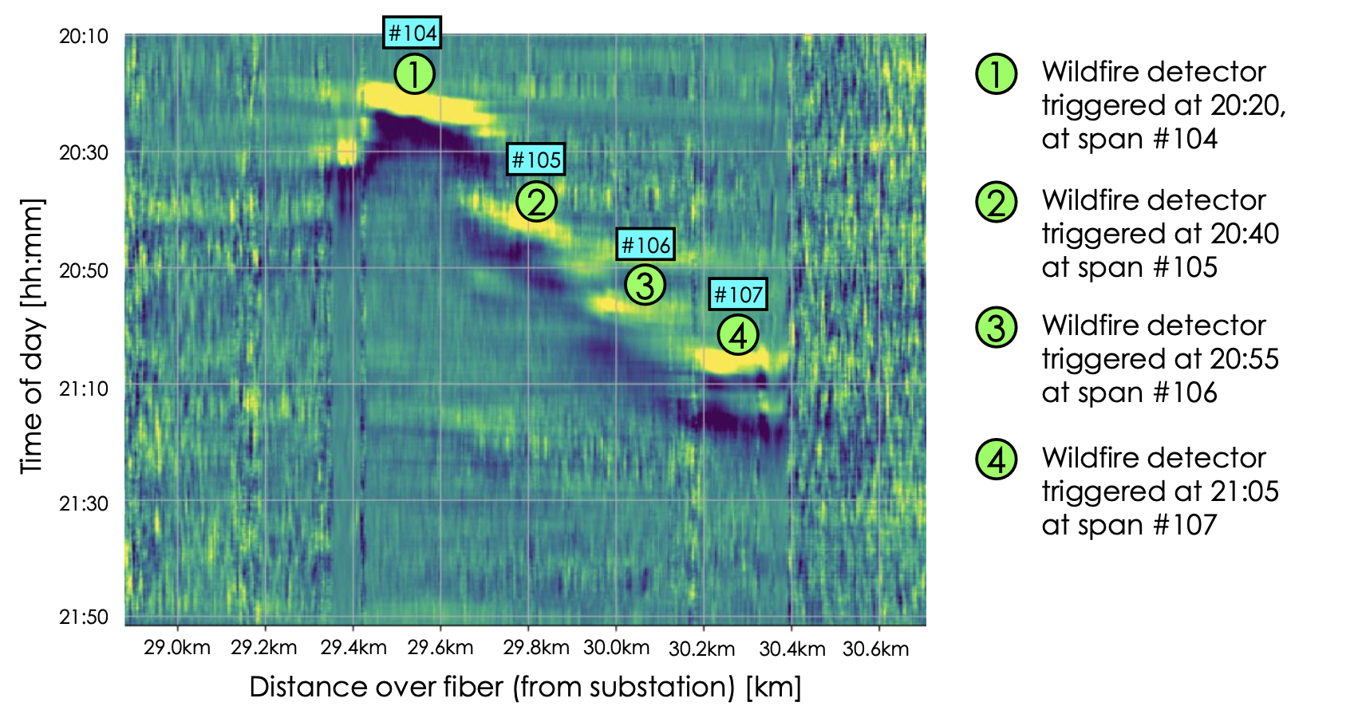
Benefits of GETs:
Monitoring and control supp0rt resilience and reliability.

Slide 25
Barriers to adoption of GETs and HPCs sustain inertia
Utility lack of experience and tools, and too much work
Misaligned incentives
Understanding benefits & costs

