Slide 1


Nevada Regional Transmission Coordination Task Force
May 7, 2026

Slide 2



RETA’s Mission
The New Mexico Renewable Energy Transmission Authority (RETA) facilitates planning, financing, developing and acquiring high-voltage transmission lines and energy storage projects to promote the expansion of carbon-free renewable energy use in state and regional markets and enhance economic development in New Mexico.
1

Slide 3
RETA Beginnings
The Renewable Energy Transmission Authority Act was passed by the New Mexico legislature and signed by Gov. Bill Richardson in 2007 to plan, finance, develop and acquire high voltage transmission lines and storage projects to promote economic development in New Mexico.
RETA is a “public body, separate and apart from the state, constituting a governmental instrumentality for the performance of essential public functions.”
There are 6 voting members on the RETA Board:
3 appointed by the Governor
1 appointed by the Speaker of the House
1 appointed by the President Pro-tem of the Senate
State Treasurer or designee
Secretary of the Energy, Minerals and Natural Resources Department serves as a non-voting ex-officio member
2

Slide 4
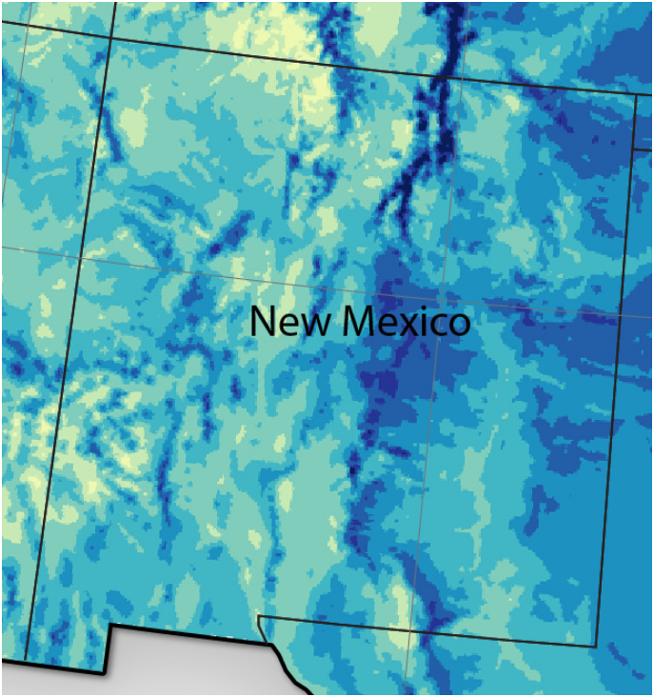
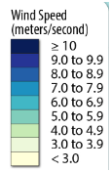
Wind Development Potential
Solar Development Potential
Total developable land area for commercially viable wind equals 20,500 square miles
18,500 square miles on State Trust and private lands
Total developable solar land area equals 68,000 square miles
49,000 square miles on State Trust and private lands
Over 9,300 square miles in highest output areas
137,000 MW
of highest quality
wind potential on
State Trust and
private lands
824,000 MW
of highest quality
solar potential on
State Trust and
private lands
3

Slide 5
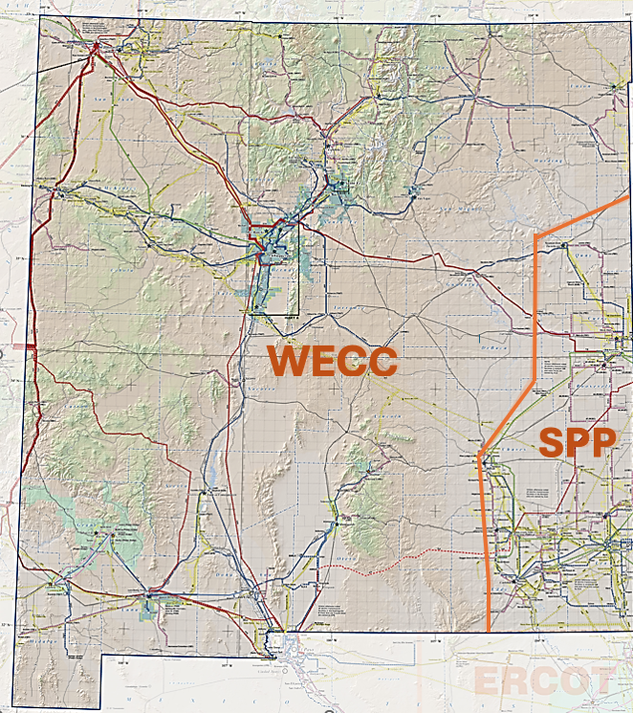
New Mexico’s Grid
Virtually unchanged since the 1980s
Borders the seam of Eastern and Western Interconnections (Southwest Power Pool & Western Electricity Coordinating Council)
WECC portion primarily fed from Four Corners coal plants both to export energy and to serve load throughout the state
Grid is not configured to support economic development from expansion of renewable resources
4

Slide 6
New Mexico’s Grid & Renewable Energy Resources
5
1

Slide 7
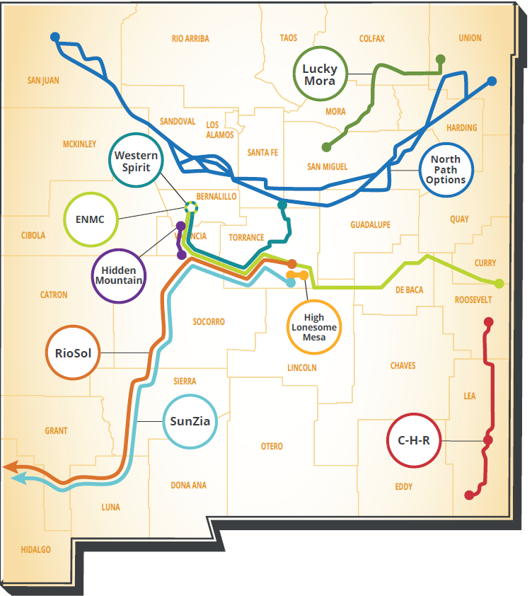
RETA’s Transmission Projects:
6
6

Slide 8
Project Capacity Summary
Western Spirit (Pattern Energy) 800 MW
SunZia (Pattern Energy) 3,000 MW
Crossroads/Hobbs/Roadrunner (NextEra) 1,500 MW
RioSol (Southwestern Power Group) 1,500 MW
North Path (Invenergy) 4,000 MW
Mora Line (Ameren) 182 MW
Hidden Mountain Extension (Auga Fria, LLC) 1,000 MW
Eastern NM Connector (ENMC, LLC) 3,000 MW
Southline Phase II (Grid United, LLC) 1,500 MW
RETA Transmission Capacity Total 16,482 MW
(Compare to New Mexico’s peak load of less than 4,000 MW)
7
7

Slide 9
How can RETA help a project get built?
RETA’s Benefits for Developers are Critical
Tax incentives
Gross receipts and compensating tax deductions
Property tax exemption for real property and improvements
Assistance with permitting and siting
Government-level relationships with State Land Office, Department of Transportation, Middle Rio Grande Conservancy District, other state and local agencies
Streamline permitting, without skirting environmental requirements
Powers of eminent domain
Bond financing
Available for developers needing financing support (not often used)
Reduced regulatory burden
8
8

Slide 10
RETA Project Relationships
Project selection process outlined in regulation - 17.8.2 NMAC (12/15/2011)
Relationship levels – all beyond NDA require Board approval
Non-Disclosure Agreement
Letter of Support
Memorandum of Understanding (this step triggers notice provisions to utilities, Public Regulation Commission and public)
Acquisition, Co-Development and Lease Agreement
Enables tax, eminent domain and regulatory benefits for project
RETA projects must transmit or store at least 30% of their energy from renewable resources. Most of RETA’s current projects are planned to have 100% of their energy originate from renewable resources.
9
9

Slide 11
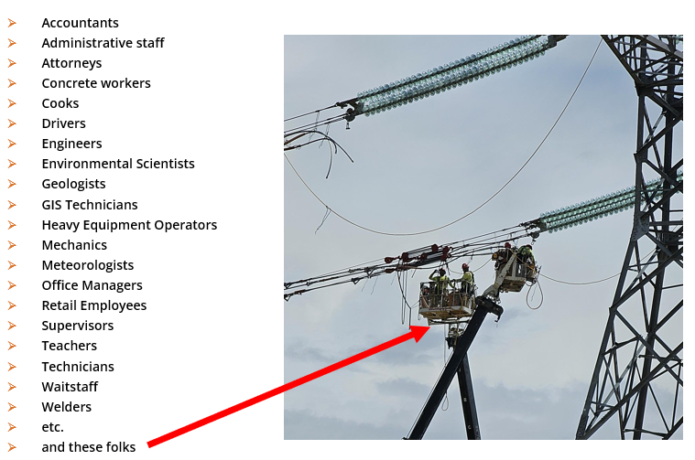
Building Transmission Lines in New Mexico Builds Our Workforce
An economic impact report recently completed for the RioSol transmission line showed:
Project development began in 2008; development expenditures are anticipated to exceed $244 million through 2025.
Project construction is estimated to begin in 2026 and continue through 2027 with total construction costs exceeding $1.75 billion.
Operations and maintenance expenditures from 2028 create economic and fiscal impacts of nearly $12.3 million per year.
These direct and induced expenditures do not include the estimated $8.6 billion investment in the renewables unlocked by the construction of RioSol.
Billions of dollars of transmission projects and thousands of jobs are some of the benefits of completed projects and others in development. RETA is the essential link in allowing our state to make renewables work and upgrading our transmission grid. RETA transmission projects are supporting renewable energy development that will help meet the requirements of the Energy Transition Act.
10

Slide 12



RETA Transmission Studies
2020/2022 Update: The New Mexico Legislature provided a special appropriation for RETA to conduct a comprehensive, state-wide transmission study. RETA contracted with ICF. That study projected:
11,500 MW of total Renewable Capacity in New Mexico by 2032
The creation of up to 3,700 construction and 800 permanent jobs related to the development construction and operation of renewable and transmission projects
Up to $11 billion of investment in the development, construction, and operation of new renewables and transmission through 2032
Available at:
https://nmreta.com/nm-reta-transmission-study/
Now: RETA has contracted with Quanta Technology to conduct a new study to identify the most economical and accessible renewable generation resources in New Mexico and the most viable transmission routes to transmit material amounts of New Mexico renewables to other markets. Report is expected May 2026.
2010: RETA’s original transmission study, conducted by Loren Toole, a researcher at Los Alamos Labs, analyzed potential upgrades for the New Mexico grid and identified the project that eventually became the Western Spirit Transmission Project.
11

Slide 13
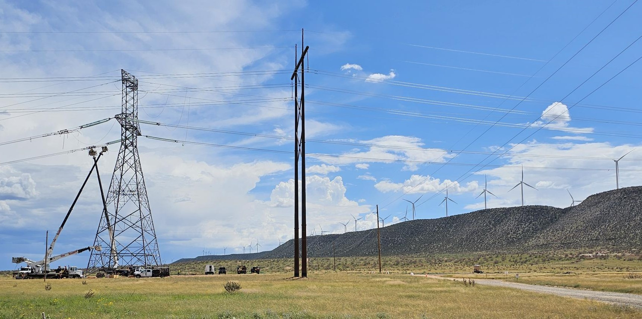
New Mexico Renewable Energy Transmission Authority
505-699-0599
www.nmreta.com
Thank you

