Slide 1
Colorado Electric Transmission Authority
Nevada Regional Coordination Task Force
February 18, 2026

Slide 2
CETA is a Transmission Developer with a Public Purpose
Mission: To plan and develop electric transmission in Colorado to 1) increase grid reliability, 2) help Colorado meet its clean energy goals, and 3) aid in economic and community development.
Organizational Structure:
Independent special purpose authority and subdivision of the state
Not subject to direction by a state agency or commission
9-member independent board appointed by governor and legislature
Powers:
Enter into public-private partnerships for transmission expansion
Identify and establish transmission corridors in the state, subject to local use permits
Issue revenue bonds to finance development and construction
Use eminent domain for right-of-way acquisition
Source: Sect. 40-42-104, CRS

Slide 3


CETA 2024 Transmission Study
In 2023, the State of Colorado directed CETA (SB23-016) to study the need for expanded transmission capacity in the State.
In response, CETA conducted an RFP process seeking an independent consultant to conduct a transmission planning study that analyzes the need for expanded capacity in Colorado to:
Help meet forecasted demand for electricity
Achieve the State’s emission reduction goals
Improve power flows on the system
Improve grid reliability
CETA hired Energy Strategies & Team to conduct the study.

Slide 4
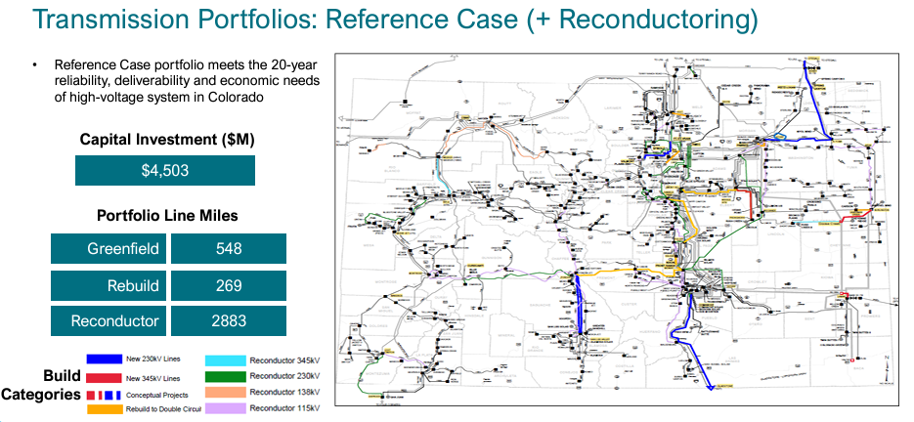
Colorado Has an Urgent Need for Transmission
Notes:
first statewide transmission study
first 20 year, long-range look at Colorado’s transmission system
extensive stakeholder engagement
informed CETA’s prioritization of six project concepts that are needed and unlikely to happen without CETA’s help.

Slide 5
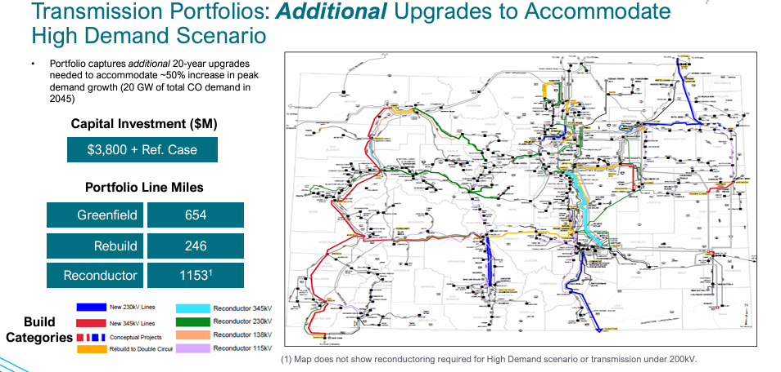
High Demand Options
Notes:
High Demand Projects: Additional $3.8 B in investment under High Demand scenario. Reference Case increase in peak demand is 40% by 2045. High Demand Scenario increase in peak demand is 100% by 2045. High Demand is a 43% increase over Reference Case.

Slide 6
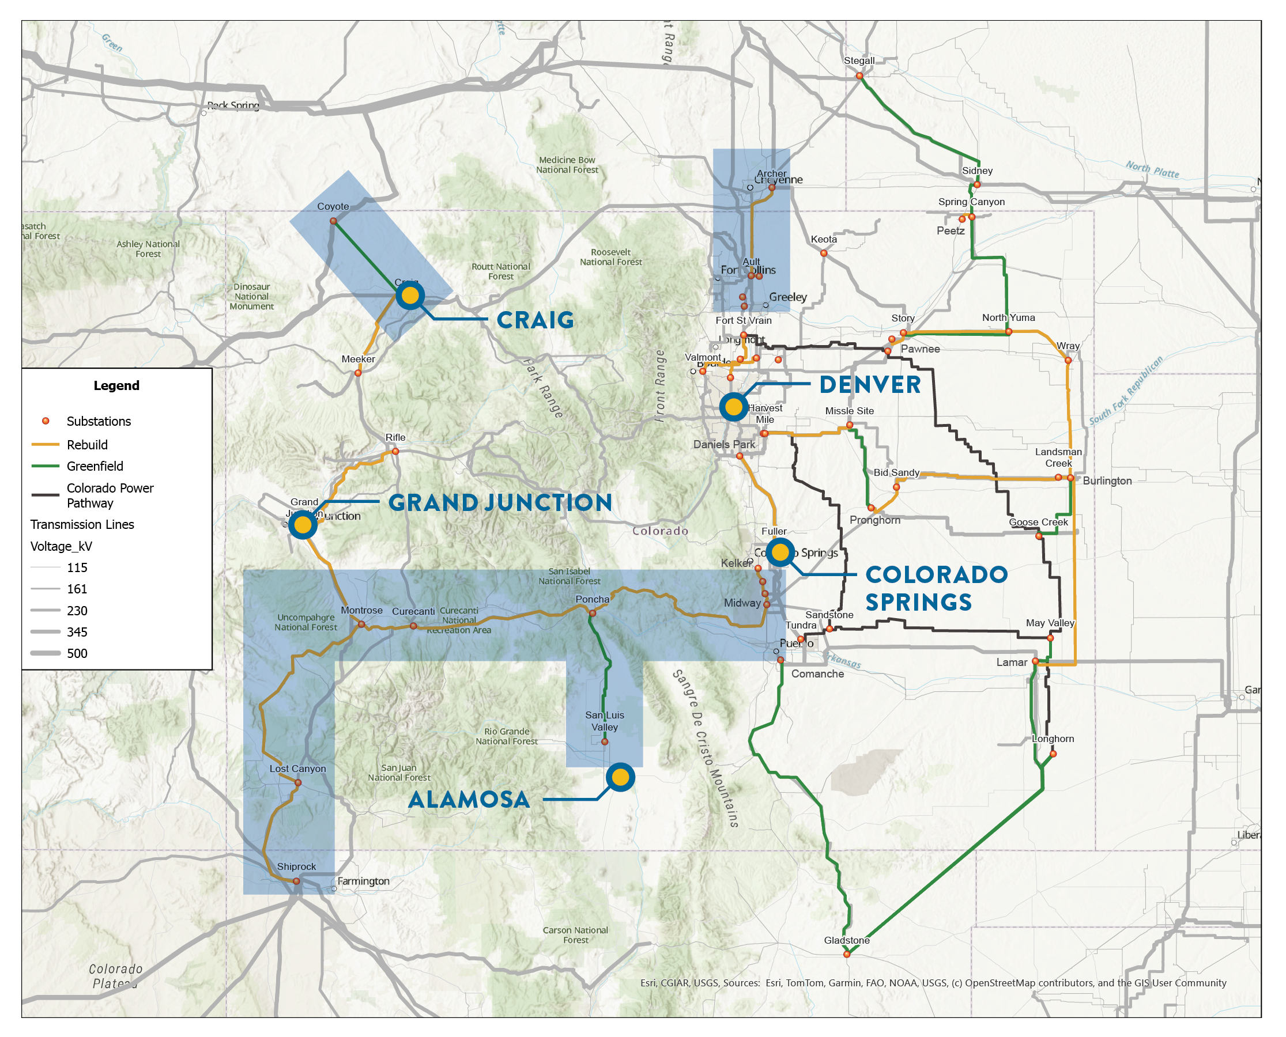
CETA’s Work
Unique Tools
Public-private partnerships
Identify transmission corridors
Revenue bonds
Eminent domain
2026 Priorities
Select a project(s) for development
Revenue bonding policy
Notification policy
Notes:
Priority concepts: strategic transmission connections that will build ties between regions in Colorado, expand access to energy markets, and/or provide redundancy to rural communities.
Transmission planning: Colorado’s legislature called for the 2024 study in state law; CETA is willing to do a similar study in the future with funding support.
Siting policies: CETA supports reasoned siting policies that are grounded in rational decision-making.

Slide 7
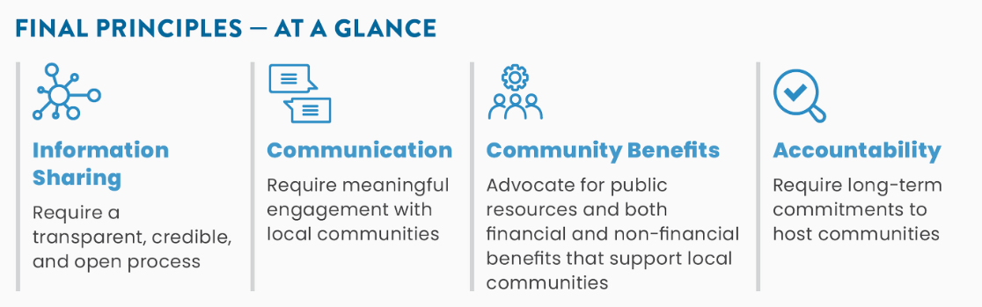
Community Engagement Principles
Principles adopted by the CETA Board in October 2024 to guide partnership agreements

Slide 8
THANK YOU
Questions?
Maury Galbraith, Executive Director
mgalbraith@cotransmissionauthority.com
Written Materials
CETA website
CETA Fact Sheet
Priority Project Concepts

